Slide 1

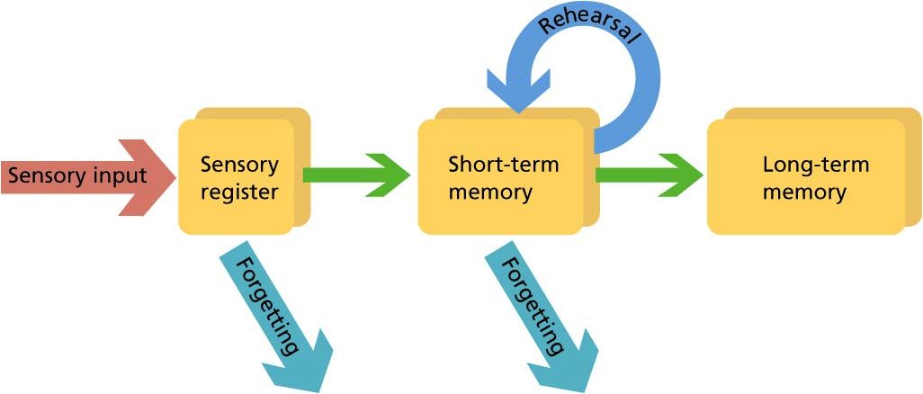
Revision techniques
Learning objective: To understand how to make an effective flashcard and use flashcards as a revision technique.
Memory recall activity:
1. Label the 3 types of memory on the diagram.
2.Describe the 3 learning strategies (retrieval practice, dual coding and elaboration).

Slide 2
Mark/develop your answers
Retrieval practice - A strategy used to enhance and boost learning through deliberately recalling information and examining what you know.
Dual coding - Combining visuals (picture) and verbal's (words) to help you retain information and retrieve it easier.
Elaboration - Making associations between the new information you're trying to learn and the information you already know by asking questions such as ‘how’ and ‘why.’
Working memory

Slide 3

Skill development
Flashcards are an effective revision technique to recall core knowledge. They can be used repeatedly to test your memory retrieval and can be effectively used by getting friends/family to test you:
https://youtu.be/A_Ro0NvttVE?list=PLJ8K__5RbGziy3GTA9hUBPK_e8nKfVaH7
Flashcards need to have a short, clear question on one side and then a short, summary answer on the back. See an example below:
State two effects of climate change |  | An increase in extreme weather events. A rise in sea levels due to thermal expansion.

Slide 4
Bayonet Charge
Written by: Ted Hughes | Written in: 1957 (post-WW2)
Title/theme | The "bayonet" is a weapon used in close combat, where the risk to personal safety is extremely great. "Charge" refers to running towards the enemy; however, "charge" also means duty.
Attitude/ atmosphere | The atmosphere in the poem is one of chaos and confusion. The adj. "raw" and verb "stumbling" emphasise the inexpert quality of the soldier and highlight his vulnerability.
Imagery | Vulnerability of soldier further emphasised in simile "He lugged a rifle numb as a smashed arm". Highlights the uselessness of his weapon/his unwillingness or inability to use it.
Language | Soldier's role in conflict questioned: "In what cold clockwork of the stars and the nations / Was he the hand pointing that second?" - "cold clockwork" indicates his participation is a cruel trick of fate.
Structure | The charge has a profound influence on the soldier as his old values - "King, honour, human dignity" - are "Dropped like luxuries". Simile indicates their worthlessness in this context.
Compare me to... The Charge of the Light Brigade Exposure (experiences of conflict) Kamikaze (power of nation)
Context Hughes' father fought in World War One. His poem explores the senselessness of war by illustrating the destructive effects of conflict on the landscape and also showing how fighting in this way goes against the soldier's nature/instinct.
What's it got to do with power? Power of nation (patriotism, duty) Power of man (destructive)
What's it got to do with conflict? The poem is set in World War One The soldier experiences internal conflict

Slide 5

Skill development
A graphic organiser is a visual tool used to show the relationship between knowledge and concepts. A typical method is creating a mind map/concept map.
A successful graphic organiser will include a range of text and visual aids (dual coding).
Types of graphic organisers:
Venn diagram
Concept map/mind map
T-chart
E
E
Prepare

Slide 6
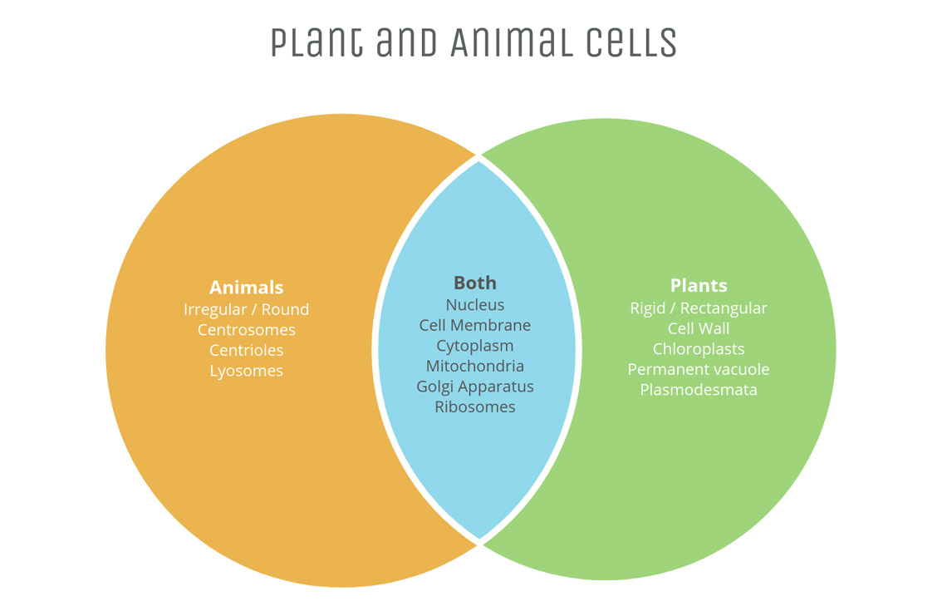
Skill development
Venn diagram: A Venn diagram shows the relationship between a group of different things (a set) in a visual way.
E
E
Prepare

Slide 7
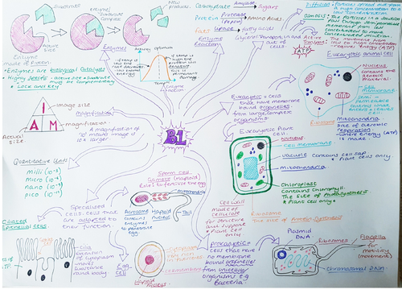
Skill development
Concept map/mind map: A concept map graphically represents the relationships between concepts or ideas.
E
E
Prepare

Slide 8
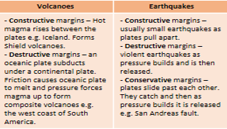
Skill development
T-chart: A graphic organiser that examines two sides of a topic e.g. pros vs. cons or facts vs. opinions.
E
E
Prepare

Slide 9
Skill development
How to make a concept map/mind map using your knowledge organiser:
https://youtu.be/tIpK1-yKWk0?list=PLJ8K__5RbGziy3GTA9hUBPK_e8nKfVaH7
Once you have created your resource, you can use memory retrieval methods to test your knowledge such as:
Look, cover, write, check, correct.
Cover sections with a post-it note with a short question written on it.
Write a low-stakes quiz.
E
E
Prepare

Slide 10
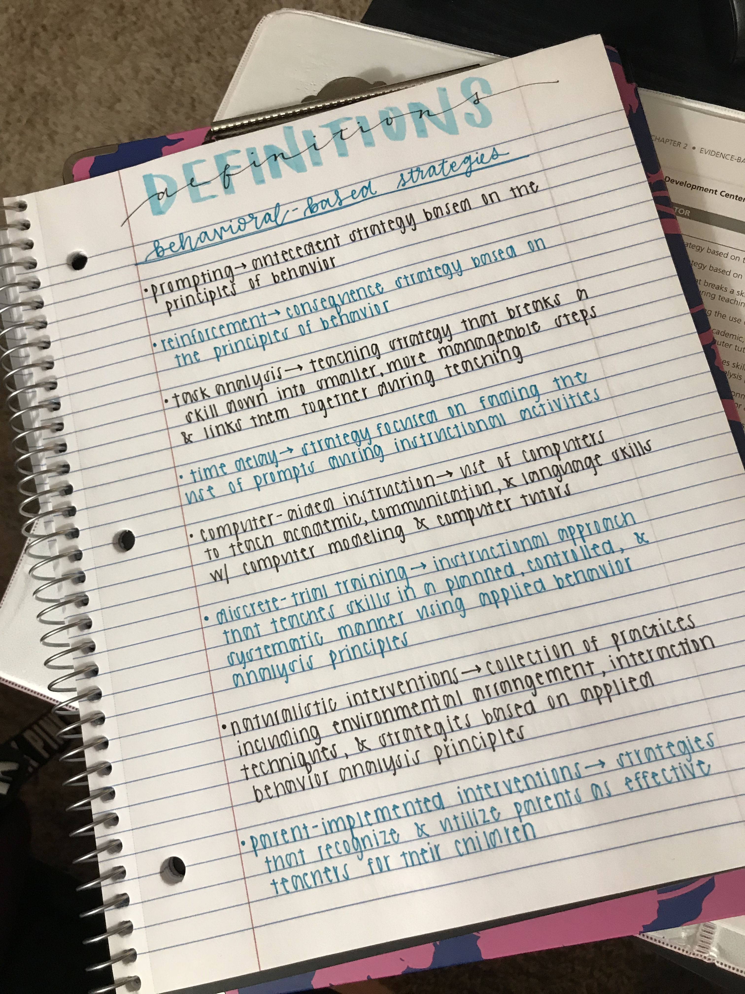
Skill development
Note taking is also an important skill; both in lessons and for revision. It is important to understand that note taking is not the same as copying down information!
The notes you take will be used for your revision at some point. It could be an end of topic test, an end of year assessment or using your Year 10 books to revise for your real GCSE exams!
Therefore it is important you make purposeful notes. Make sure your notes are as neat as possible, well structured, use headings/sub-headings, label diagrams, highlight key terms, develop your work in green pen etc.
E
E
Prepare

Slide 11
Skill development
The purpose of taking notes is to record the most important information for you to later recite. To do this effectively, use the rule of SCORE:
Select the most important information (things you didn’t already know/understand)
Condense the information into short points
Organise your notes with sub-headings
Rephrase sentences so they are in your own words and in a language you understand
Elaborate; make connections between knowledge
E
E
Prepare

Slide 12

Independent practice
Physics - Gravitational fields:
All objects with mass produce a gravitational field. The more mass an object has, the greater its gravitational field will be.
Weight is the force acting on an object due to gravity - it has the unit newtons (N) and acts towards the centre of a gravitational field. The weight of an object can be measured using a calibrated spring-balance, often called a Newton meter.
Weight is a non-contact force because gravity exerts its force through a field. An object does not need to be touching the Earth to have a weight. Gravitational field strength (g) is measured in newtons per kilogram (N/kg). The Earth's gravitational field strength is 9.8 N/kg. This means that for each kg of mass, an object will experience 9.8 N of force.
Where there is a weaker gravitational field, the weight of an object is smaller. For example, the gravitational field strength of the Moon is 1.6 N/kg. This means that for each kg of mass, an object will experience 1.6 N of force. Therefore, an astronaut will weigh less on the Moon than they do on the Earth.
Weight caused by gravity is not always obvious. Astronauts on the International Space Station appear to be weightless. However, they are still orbiting the Earth and are within its gravitational field, so they still have weight. They seem to be weightless because both they and the space station are constantly falling towards the Earth.
Task - In your exercise book, practice making notes on this information using the rule of SCORE:
Select the most important information (things you didn’t already know/understand)
Condense the information into short points
Organise your notes with sub-headings
Rephrase sentences so they are in your own words and in a language you understand
Elaborate; make connections between knowledge
E
E
Prepare

Slide 13
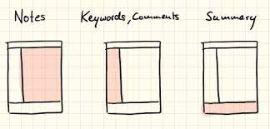
Independent practice
You are now going to practice Cornell note-taking using one of your KOs. Instructions:
Split a page in your exercise book as shown in the diagram
Give your page a relevant title at the top e.g. River landscapes
Make short summary notes in the largest section (right-hand column)
Along the left-hand column, write questions to test the knowledge from the right-hand column
Write a summary of the topic at the bottom
E
E
Prepare

