Slide 1

Revision technique - Quizzing
E
E
Prepare
Learning objective: To understand how to use quizzing as a revision technique.
Memory recall activity – Answer the following questions:
What are the 3 types of memory called?
What are the 3 strategies of learning we studied called?
State one ‘do’ of revision and one ‘don’t’

Slide 2
Mark/develop your answers
What are the 3 types of memory called? Short-term, working memory and long-term
What are the 3 strategies of learning we studied called? Retrieval practice, dual coding and elaboration
State one ‘do’ of revision and one ‘don’t’
Do | Don’t
Use a variety of techniques Create a positive working environment Eat healthy snacks before and during revision Revise for no more than 90 minutes at a time and take regular breaks Space out your revision Test yourself Focus on the things you don’t know, rather than things you know best Use an effective study plan/schedule Start early to avoid cramming | Read over notes Revise for long periods of time Revise with the TV on

Slide 3
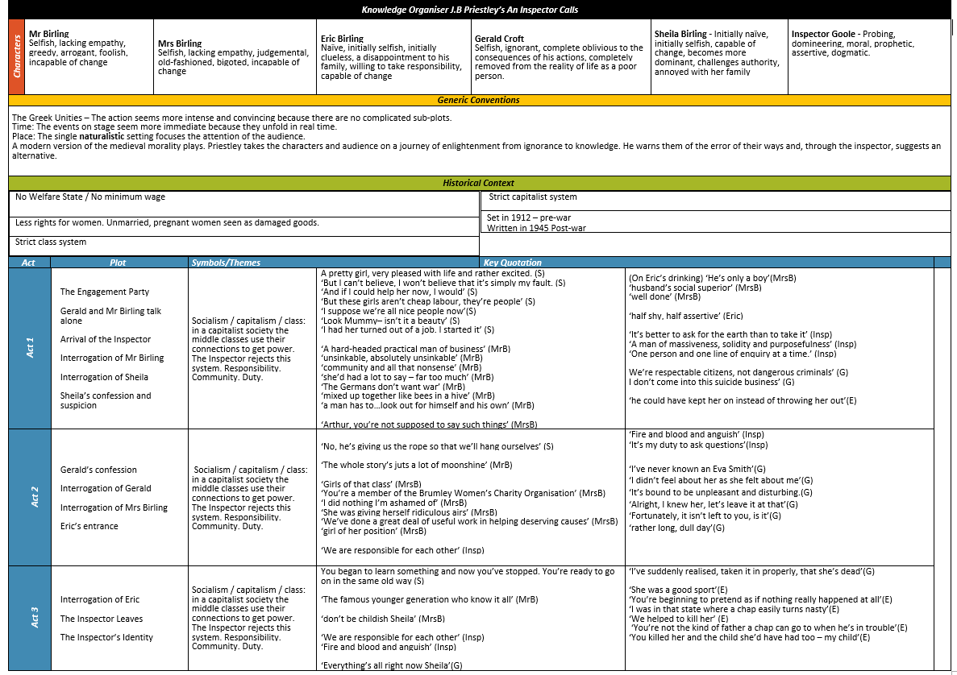
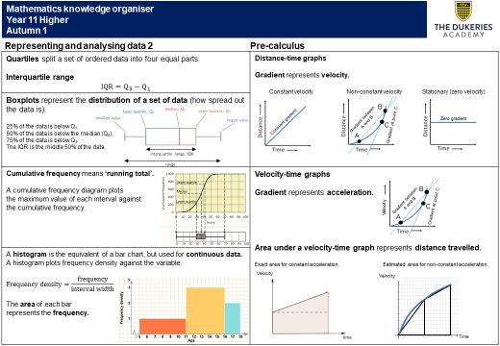

Revision techniques
Over the next few lessons you will learn about a range of effective revision techniques. To practice each of these methods, you will be utilising the knowledge organisers (KO) produced by your teachers for each topic.
KO show condensed information for each topic including definitions of key terms, core knowledge, answering core questions, important dates and case study information. These KO are a starting point for your revision and must not be your only source of revision! Here is an example from English and Maths:
E
E
Prepare

Slide 4

Skill development
Quizzing is an important revision tool. It helps you to test your knowledge and identify gaps in knowledge as well.
Types of quizzing:
Multiple choice quiz
Correctly label a diagram
Recalling a key fact/date
True/false questions
Elaboration questions (explaining how or why)
Fill in the blanks

Slide 5
London
Written by: William Blake | Written in: 1794 (18th century)
Title/theme | The name 'London' refers to the capital city and is the seat of power in this country (government/monarchy). Despite its grandiose connotations, it is home to great poverty and suffering.
Attitude/ atmosphere | The speaker's attitude is critical; he dislikes the rigidity of the city – repetition of "charter'd" – and sees everyone as trapped; he alone may "wander" (verb connotes freedom).
Imagery | Blake's metaphor of "mind-forg'd manacles" represents psychological oppression/the poor being punished. Adjective 'mind-forg'd' could suggest the people could be freed.
Language | Blake associates negative language with powerful institutions – "blackning Church", "blood" and "Palace". He is criticising these rich organisations for failing their people.
Structure | Blake's final message reinforces the cyclical, never-ending nature of suffering in the city: "blights with plagues the Marriage hearse". Emotive language/semantic field of disaster.
Compare me to... London (theme of oppression) The Émigrée (overcoming oppression)
Context Blake was born and raised in London, so witnessed firsthand the strife of its people. He believed in God, but disapproved of organised religion, feeling that the Church, like the monarchy, neglected the poor. He shared in the ideals of revolutionaries.
What's it got to do with power? Power of the individual (to think freely/resist oppression) Power of the oppressor (mighty and destructive)
What's it got to do with conflict? There is conflict between the speaker and his oppressors

Slide 6

Independent practice
Task: Use the knowledge organiser for the London poem to create a low-stakes quiz
Instructions:
Write clear questions to the facts on the sheet
Turn your sheet over so that you can’t see the information and answer the questions
Turn your sheet back over and mark your answers. Any you got wrong, answer in a different colour as you will learn from this mistake and store this information visually.

