Slide 1
Creating and utilising a revision timetable
Learning objective: To understand the importance of using a revision schedule and produce a revision timetable.
Memory recall activity: Match the description to the type of learning strategy.

Slide 2

Develop/mark your answer in green pen
Learning strategy |  | Description
Retrieval practice |  | Combining visuals (picture) and verbal's (words) to help you retain information and retrieve it easier.
Elaboration |  | A strategy used to enhance and boost learning through deliberately recalling information and examining what you know.
Dual coding |  | Making associations between the new information you're trying to learn and the information you already know by asking questions such as ‘how’ and ‘why.’
E
E
Prepare

Slide 3

Skill development – making a revision timetable
Making a revision schedule:
Chunk your revision → 20-30 minutes at a time with regular breaks
Put harder subjects earlier in the day
Share your revision schedule with family and friends so they are aware of your plans
Don’t overload your revision timetable → if it is unrealistic you won’t stick to it
Advice from students:
https://www.bbc.co.uk/bitesize/articles/zn3497h
E
E
Prepare

Slide 4

Independent practice – do and don’t
Categorise the statements below
Do | Don’t
Create a positive working environment | Read over notes | Use a variety of techniques
Revise for long periods of time | Eat healthy snacks before and during revision | Revise for no more than 90 minutes at a time and take regular breaks
Space out your revision | Test yourself | Revise with the TV on
Focus on the things you don’t know, rather than things you know best | Use an effective study plan/schedule | Start early to avoid cramming
E
E
Prepare

Slide 5
Independent practice – do and don’t
Do | Don’t
Use a variety of techniques Create a positive working environment Eat healthy snacks before and during revision Revise for no more than 90 minutes at a time and take regular breaks Space out your revision Test yourself Focus on the things you don’t know, rather than things you know best Use an effective study plan/schedule Start early to avoid cramming | Read over notes Revise for long periods of time Revise with the TV on
E
E
Prepare

Slide 6
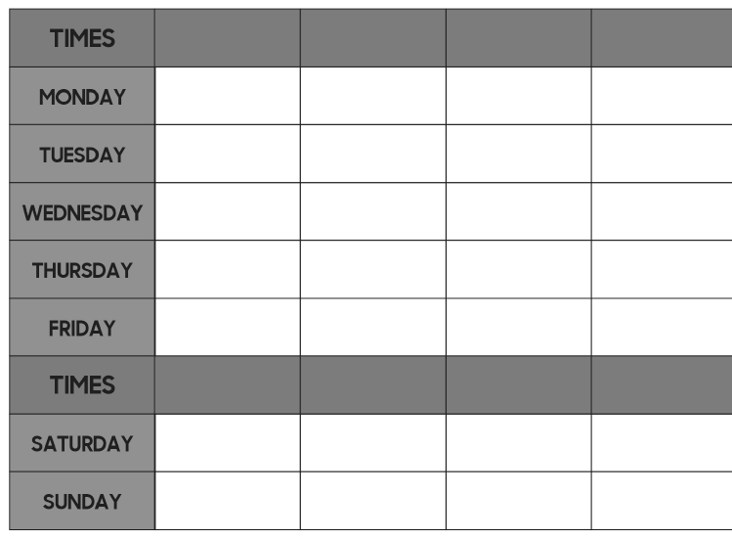
Independent practice – create your own
Task – You are going to create your own revision timetable. First of all, you need to list all of your subjects! Then, add in the time slots for your revision.
5:00 – 5:30pm
5:45 – 6:15pm
6:30-6:45pm
7:00 – 7:30pm
Subjects:
English Literature
English Language
Maths
Chemistry
Biology
Physics
…
10:00 – 10:30am
10:45 – 11:15am
11:30 – 12:00pm
12:15 – 12:45pm
E
E
Prepare

