Slide 1

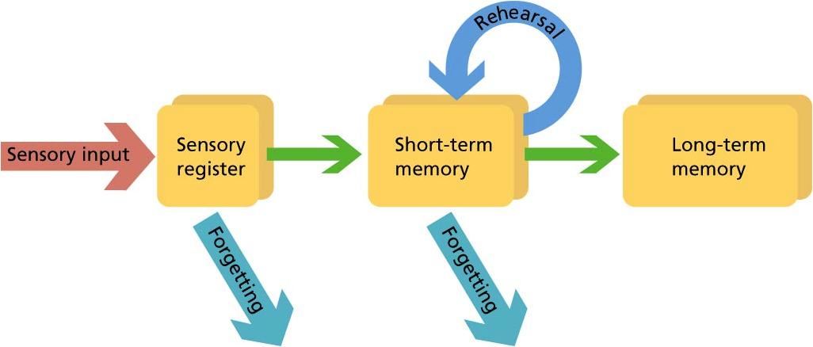
Title – Learning how to learn
E
E
Prepare
Learning objective: To know about different practices used to support learning and practice using these.
Memory recall activity:
What is the difference between
short-term memory, long-term
memory and working memory?
Working memory

Slide 2
Develop/mark your answer in green pen
Short-term memory = recalling a limited amount of information for a short period of time. These usually disappear after 30 seconds.
Working memory =
retaining information in order to manipulate it.
Long-term memory = recalling information after a long period of time.
Working memory

Slide 3

Learning focus – how to learn
What is meant by the term learning?
What strategies can be used to help us learn?

Slide 4
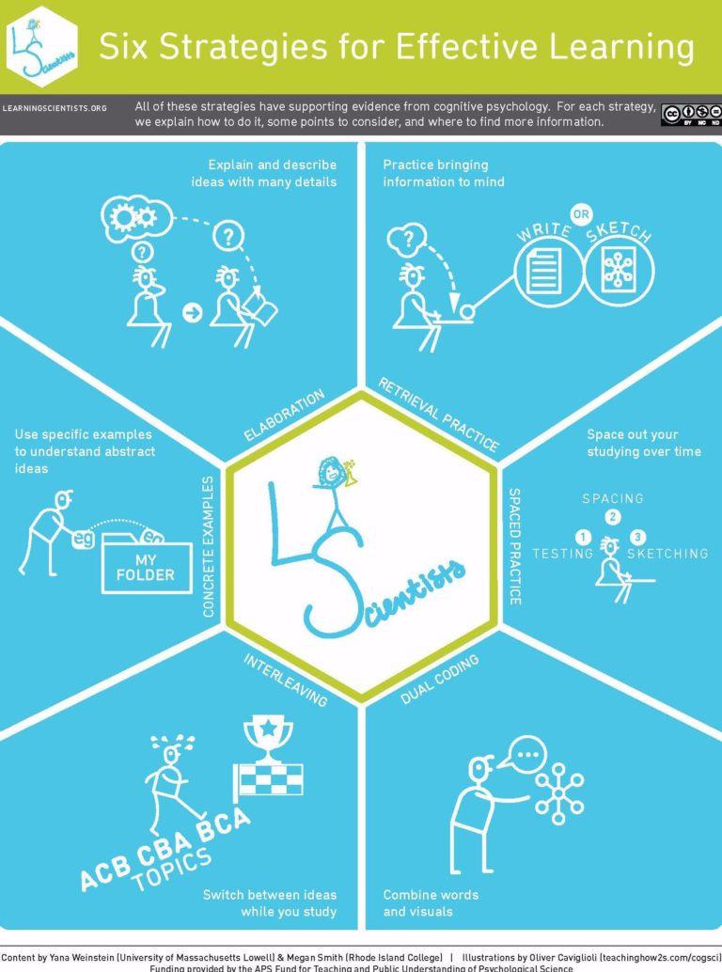
Learning focus – how to learn
Learning refers to knowledge acquired through study, experience, or being taught.
There are hundreds of different methods that can be used to help you learn, today we are going to focus on 3:
RETRIEVAL PRACTICE
DUAL CODING
ELABORATION
For today’s lesson, you will need one knowledge organiser to complete the ‘independent practice’ activities.

Slide 5
Checking Out Me History
Written by: John Agard | Written in: 2007 (modern)
Title/theme | The title refers to the speaker's mission to discover his heritage and educate himself. For him, 'history' is linked to identity. Speaker criticises those who have denied him this knowledge.
Attitude/ atmosphere | The speaker is angry/feels whose sense of self has been impaired (verbs in "bandage up me eye", "blind me" - connote suffering). Use of vernacular shows defiance; he resists control.
Imagery | Agard juxtaposes the absurd imagery of nursery rhymes with the real life achievements of Black people ("de dish ran away with de spoon"). Emphasises the injustice.
Language | Agard uses metaphors to emphasise how important his Black role models are (including "beacon", "healing star", "yellow sunrise"). Shows their symbolic importance.
Structure | At the end of the poem, Agard repeats "Dem tell me" from the beginning. This time, he overcomes: "I carving out me identity". Verb 'carving' deliberate, empowering.
Compare me to... London (theme of oppression) The Émigrée (overcoming oppression)
Context Agard was born in Guyana when it was a British colony, meaning the curriculum was Eurocentric (from a European perspective, erasing the importance of other cultures). His poem celebrates the lives of little-known, real Black heroes.
What's it got to do with power? Power of the individual (can be stifled, but not stopped!) Power of the oppressor (significant, but can be overcome)
What's it got to do with conflict? There is conflict between the speaker and his oppressors

Slide 6
Skill development – retrieval practice
Retrieval practice is the ability to retrieve information from memory, without the information in front of you. In lessons, you have practiced these as your ‘memory recall activities.’
This can be done in two ways:
Read through information on a particular topic for a short amount of time. Then, put the information resource away and write down everything you can remember. Once you have done this, add in anything you missed in a different colour using your information resource again.
Pick a topic and write down everything you can remember about that topic (brain dump). Then, use an information resource about that topic to add in anything you have missing in a different colour.

Slide 7

Independent practice – retrieval practice
Lets try this together. Our chosen topic is the poem ‘Checking out me history’ Brain dump everything you know about this poem:
POEM
Checking out me history
Notes:
As a teacher you can choose any topic you like

Slide 8
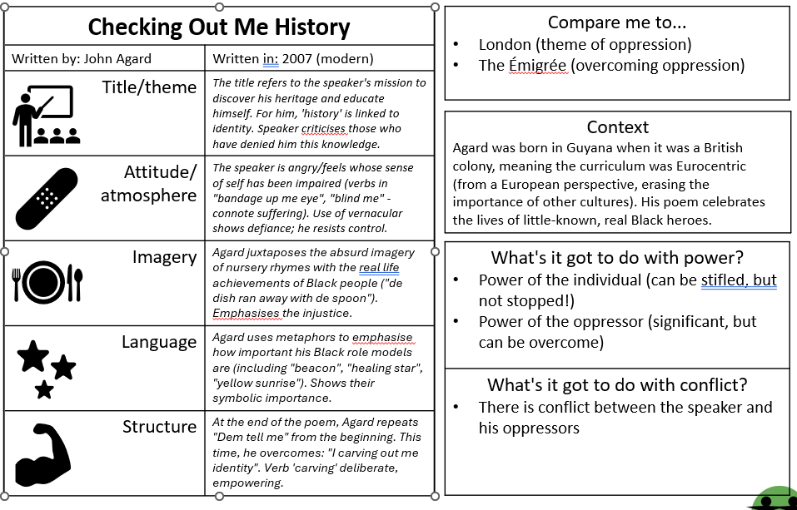
Independent practice – retrieval practice
You then add anything you have missing from your brain dump, using an information resource such as a knowledge organiser, in a different coloured pen:
Notes:
As a teacher you can choose any topic you like

Slide 9
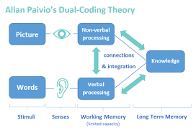

Skill development – dual coding
Dual coding is combining words and visuals such as pictures/diagrams. Using both visual (picture) and verbal (words) helps you retain information and retrieve it easier.
Research into dual-coding has found that:
Students who revised with words and pictures performed twice as well in a problem solving test compared to those who had just revised with just words
Students who learn with both words and pictures remember around 50% more than those who revised by seeing words and then separately later seeing pictures
https://youtu.be/6xCZ4XnkpCc
E
E
Prepare

Slide 10
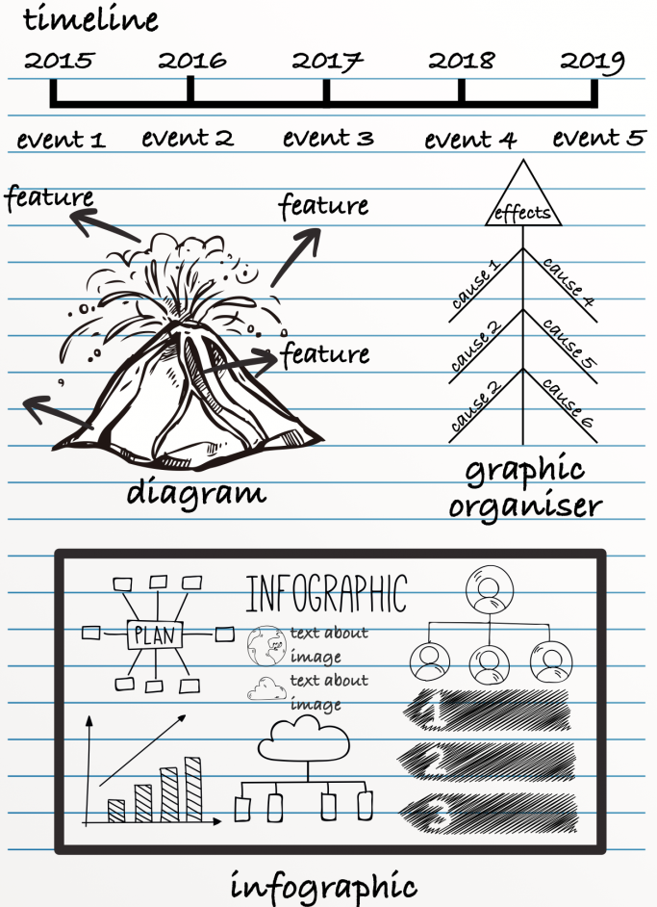
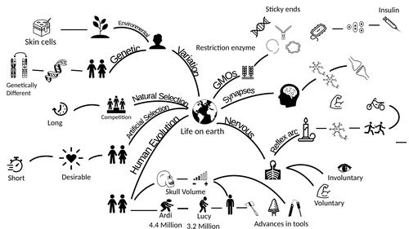
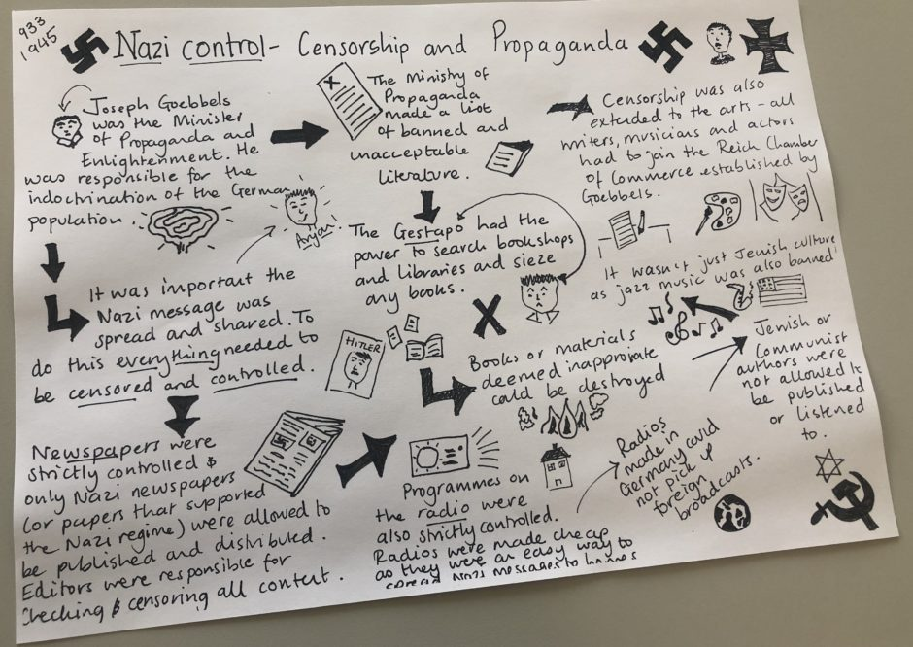
Skill development – dual coding
Here are some examples:

Slide 11
Independent practice – dual coding
Tasks:
Pick 3 difficult key terms to remember from your knowledge organiser.
Write down the key term in your exercise book.
Then, draw a simplistic diagram/picture to help you remember what that key term means.

Slide 12
Skill development - elaboration
Elaborative rehearsal is a way to more effectively memorize information and maintain it in your long-term memory.
By making associations between the new information you're trying to learn and the information you already know, you're making your brain process the information in a more in-depth way:
https://youtu.be/gQRzW24KrDc

Slide 13
Independent practice
This strategy is about asking ‘how’ or ‘why.’ What has x to do with y? How does a help me to explain b?
Examples:
When did the First World War start? 3rd September 1914: Why?
Which rocks are formed from molten rock? Igneous. How?
When was the amendment to the Poor Law? 1834: How does Dickens explore this in A Christmas Carol?
Task - Pick one of your knowledge organisers and try this method for two or more facts.

Slide 14
Independent practice
Task - Choose ONE of the three strategies we have learnt about today and use one of your knowledge organisers for this term to practice the strategy:
RETRIEVAL PRACTICE
DUAL CODING
ELABORATION
Remember, the aim is to acquire knowledge (store in your working memory from your long-term memory).

