Slide 1
Title - Memory
Learning objective - To understand what is meant by the term ‘memory’ and types of memory.

Slide 2


Learning focus - memory
What is meant by the term memory?
What different types of memory are there?
E
E
Prepare

Slide 3
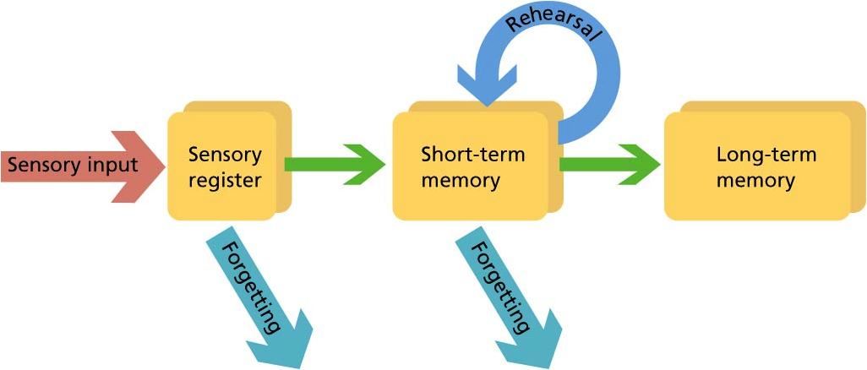
Learning focus - memory
Memory is the means by which we draw on our past experiences in order to use this information in the present.
Working memory
E
E
Prepare

Slide 4
Learning focus - memory
Short-term memory – recalling a limited amount of information for a short period of time. These usually disappear after 30 seconds.
Try to remember each of these words:
Tree | Throw | Picture
Dog | Society | Table
Tower | Pollution | Running
E
E
Prepare
Notes:
Don’t let pupils write them down – only show it for a short period of time e.g. 10 seconds

Slide 5
Learning focus - memory
Short-term memory – recalling a limited amount of information for a short period of time. These usually disappear after 30 seconds.
How many of the words can you remember?
Tree | Throw | Picture
Dog | Society | Table
Tower | Pollution | Running
E
E
Prepare

Slide 6
Learning focus - memory
Without rehearsing information our short term memory is lost. The key is to store this information in our long term memory.
Working memory
E
E
Prepare

Slide 7
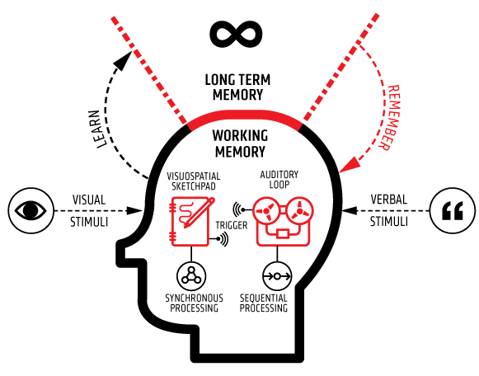
Learning focus - memory
Long-term memory – recalling information after a long period of time.
Once this information is stored in your long-term memory, you will be able to retrieve it into your working memory to use during assessments.
E
E
Prepare

Slide 8
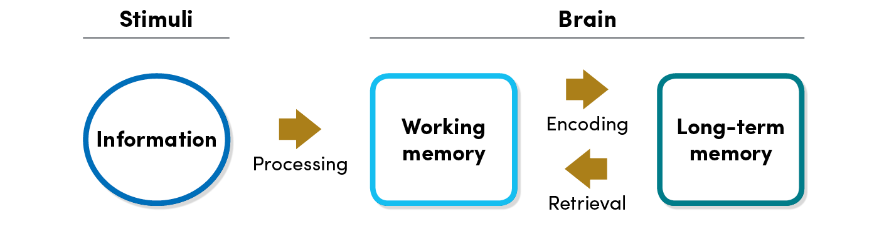
Learning focus - memory
Working memory – retaining information in order to manipulate it.
This is part of your short term memory as you can only store a small amount of information here.
The key is to store information in your long term memory and then use memory recall activities to remember the information.
E
E
Prepare

Slide 9
Learning focus - memory
I am now going to give you longer to remember this information. This time, tell yourself a story to remember as many of the words as you can.
E.g. I was running with my dog when I passed a picture of a tree.
Tree | Throw | Picture
Dog | Society | Table
Tower | Pollution | Running
E
E
Prepare
Notes:
Don’t let pupils write them down – this time show it for 30 seconds.

Slide 10
Learning focus - memory
How many of the words can you remember?
Write your story in your book and then you will tick off how many words you could remember.
Tree | Throw | Picture
Dog | Society | Table
Tower | Pollution | Running
E
E
Prepare

Slide 11
Learning focus - memory
Working memory
TED Talk - How your working memory makes sense of the world.
https://www.ted.com/talks/peter_doolittle_how_your_working_memory_makes_sense_of_the_world/up-next?language=en
E
E
Prepare
Notes:
9 minutes

