Slide 1
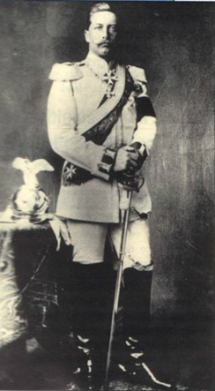
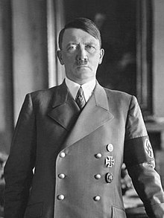
Germany 1918-39
Weimar and Nazi Germany 1918-30. Unit 1: The Weimar Republic
The Bigger Picture
Unit 1: The Weimar Republic 1918-30
  Life under the Kaiser
  Impact of WWI on Germany
  The Origins of WR
  Treaty of Versailles
  Political Threats
  The Invasion of the Ruhr
  Hyperinflation
  Gustav Stresemann
Unit 2:The rise of Hitler and the Nazi Party 1919-33
Unit 3: Nazi Consolidation of Power 1933
Unit 4: Nazi Control and Dictatorship 1933-39

Slide 2
MOCK OPTION 2

Slide 3
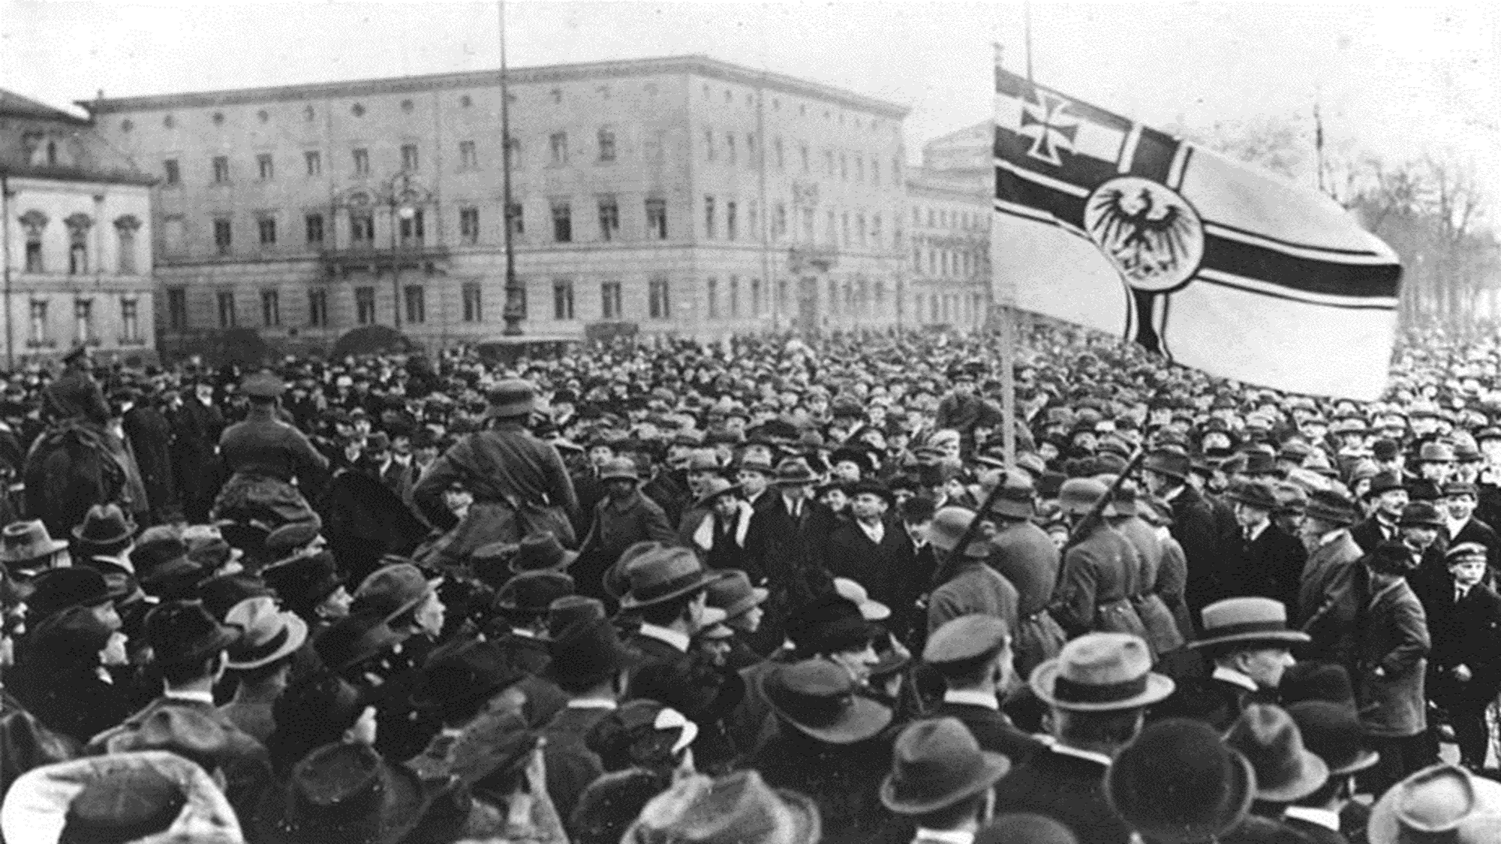
Exam Practice: 2018 GCSE paper

Slide 4
Exam Practice: 2018 GCSE paper

Slide 5


Slide 6
Exam Practice: 2018 GCSE paper

Slide 7


Slide 8

Question 3d - 30 minutes
How far do you agree with Interpretation 1 about an aspect of Germany? (16 marks + 4 SPAG marks)
Paragraph 1: Interpretation 1 supports the view that…
The source says ‘… ’. This means… From my own knowledge I know this to be true because… (Write this 2 or 3 times)
Bonus: Can you explain one quote you disagree with and why?
Paragraph 2: On the other hand, Interpretation 2 challenges the view that….
The source says ‘… ’. This means… From my own knowledge I know this to be true because… (Write this 2 or 3 times)
Bonus: Can you explain one quote you disagree with and why?
Paragraph 3: Overall… In conclusion, I agree more with interpretation… because…
On the other hand, I agree with interpretation … because….
Nevertheless…. interpretation… is more convincing because…
BE CONFIDENT/ASSERTIVE ABOUT THE ONE YOU AGREE WITH
Paper 3, Section B: 3a - 15 minutes How useful are Sources B and C for an enquiry into…. (8 marks)
Source B is useful because it suggests …This is supported by my contextual knowledge…. (x3) (quote, explain, own knowledge x3)
Moreover Source B is also useful because… and less useful because (Nature, Origin, Purpose- take each one in turn) This is supported by (my contextual knowledge)….
Brief conclusion/judgement on the usefulness of the source with regards to the question
REPEAT FOR SOURCE C
Paper 3, Section B: Q3b - 5 minutes
Study Interpretations 1 and 2. They give different views about …How are the views of the 2 interpretations different? (4 marks)
The main difference is that Interpretation 1 says…. The part of the interpretation to support this is.… This means that…
Whereas, interpretation 2 says…. The part of the interpretation that supports this is…. This means that…
Paper 3, Section B: Q3c - 5 minutes
Why do Interpretations 1 and 2 give different views about... Use the interpretations and sources to help you answer the question (4 marks)
The reason the 2 interpretations give different views is because they give weight to different sources. For example Interpretation 1 gives more weight to Source _____ The source and the interpretation agree about…. This means/suggests….
Whereas, Interpretation 2 gives more weight to Source _____ The source and the interpretation agree about…. This means/suggests….

Slide 9
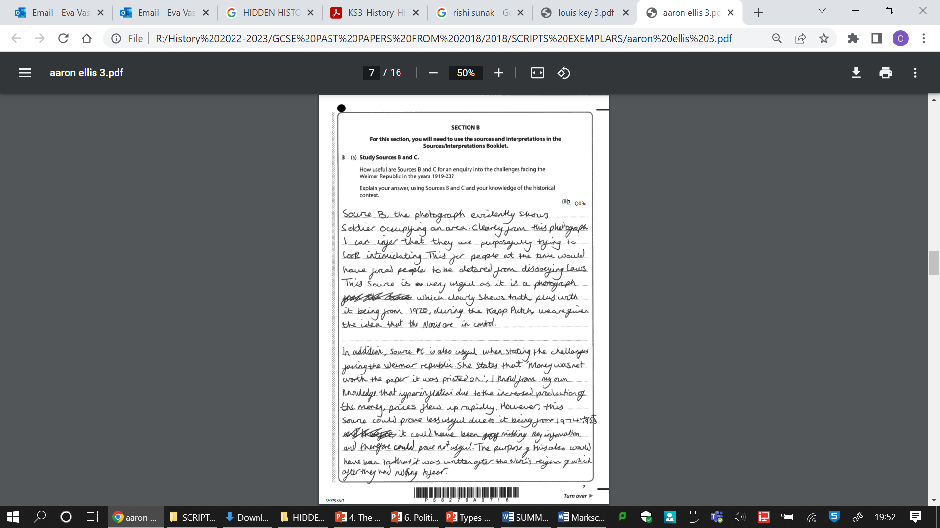
Level/ Mark | Utility… Criteria Analysis and evaluation of source utility AO3
Level 1 (1-2 marks) | A simple judgement on utility is given and supported by undeveloped comment on the content of the sources and/or their provenance. Simple understanding of the source shown by picking out, repeating or summing up. (quote or paraphrase used) Limited own knowledge and some links to the sources.
Level 2 (3-5 marks) | Judgement on how useful the sources are using some criteria (e.g. accuracy, completeness or objectivity) is made. Some analyses/explanation of the source content using quotes and description Using some own knowledge to evaluate the source and/or provenance (NOP). Own knowledge sometimes directly links to the usefulness and/or provenance.
Level 3 (6-8 marks) | Clear judgement on how useful the sources are using clear criteria (e.g. accuracy, completeness, objectivity) is explained. It is supported with clear inferences about the content which is analysed well to argue about how useful the source is Own knowledge used to evaluate. The impact of the provenance (NOP) on the content is explained.
Assessment Checklist- Utility |  | Well done | Target
Content | 2-3 pieces specific evidence (quotes) from the source
 | Evidence is explained
 | Supporting knowledge is used
Provenance | Nature (useful and/or limitation)
 | Origin (useful and/or limitation)
 | Purpose (useful and/or limitation)
Both Sources
Judgement o utility for each source
LEVEL: 1 2 3 4 Mark:
Notes:
2 MARKS

Slide 10
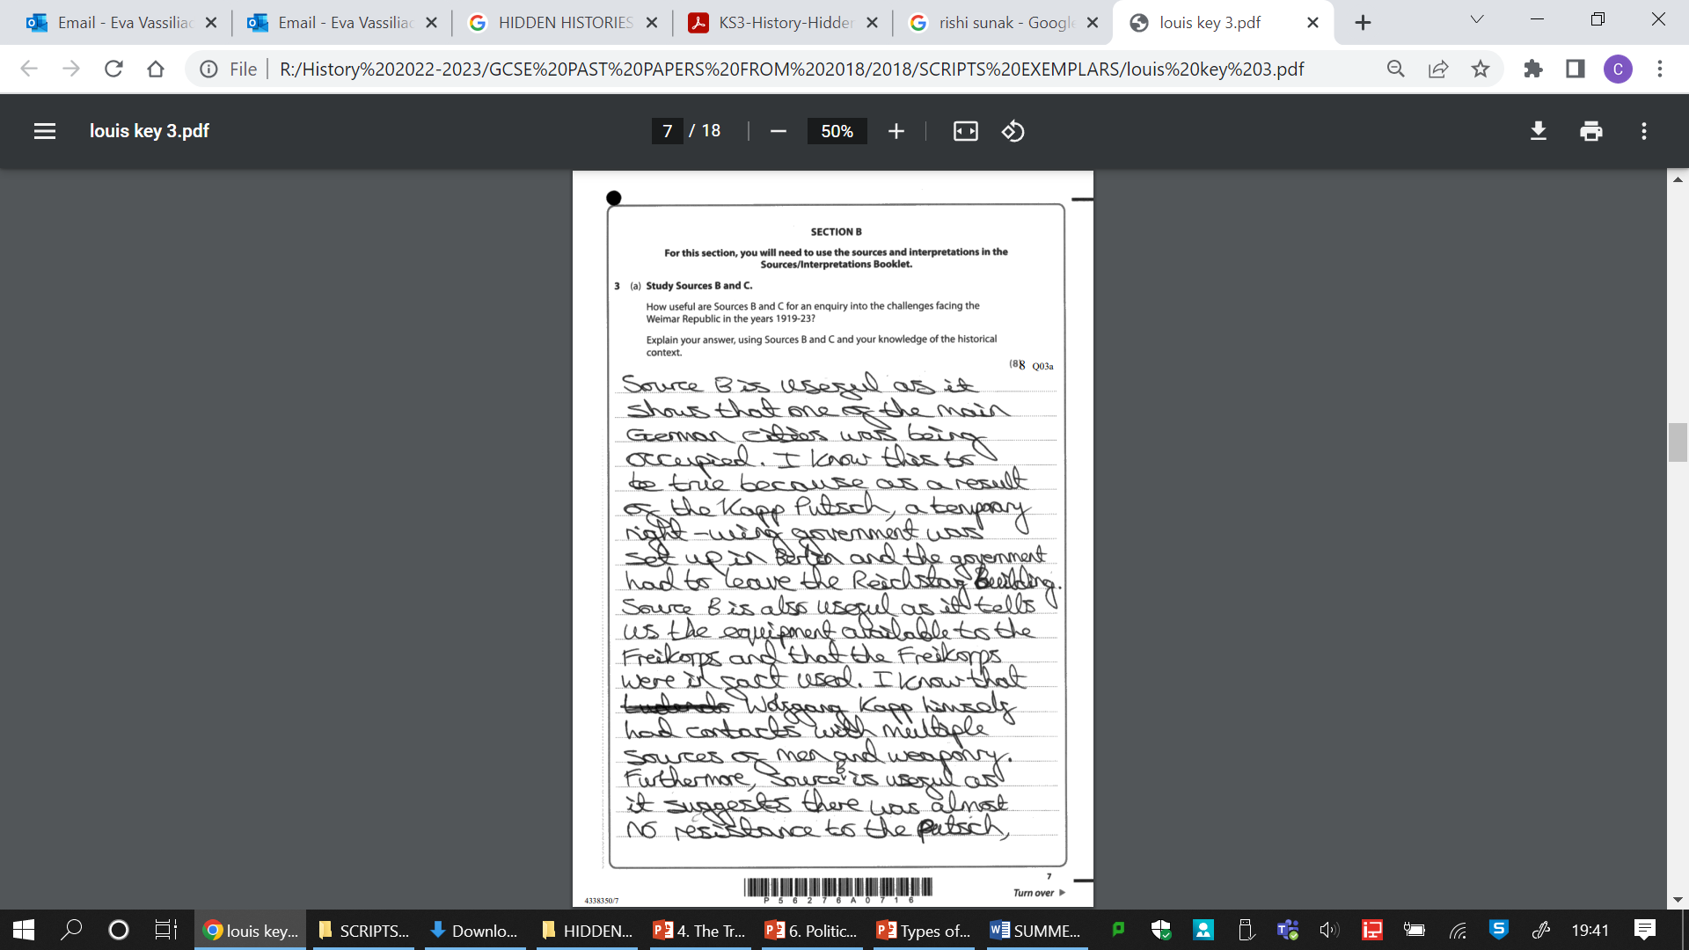
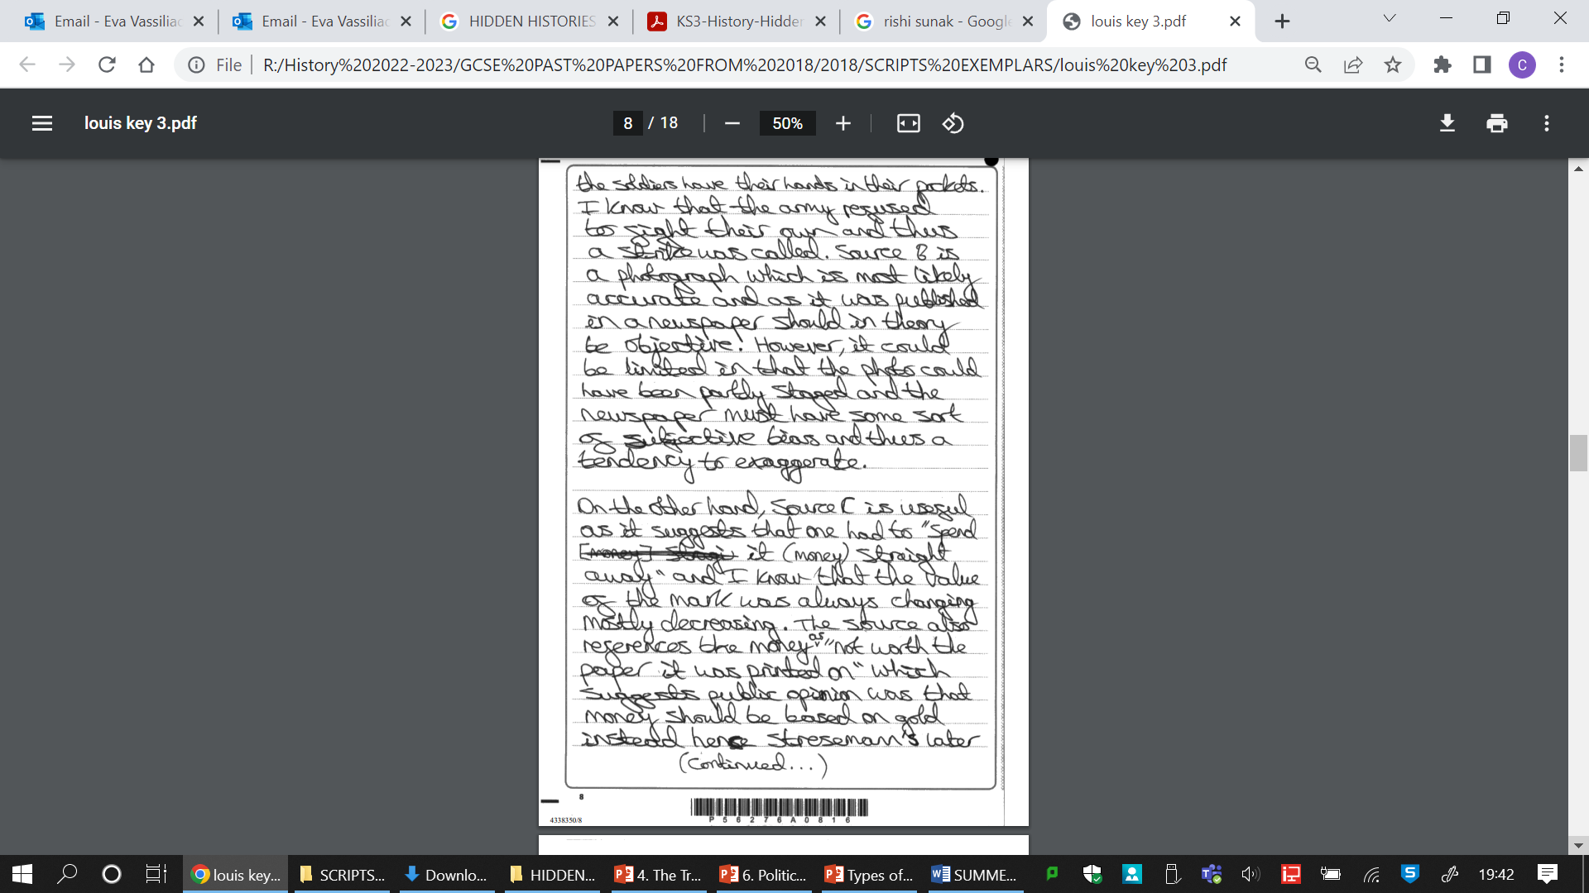
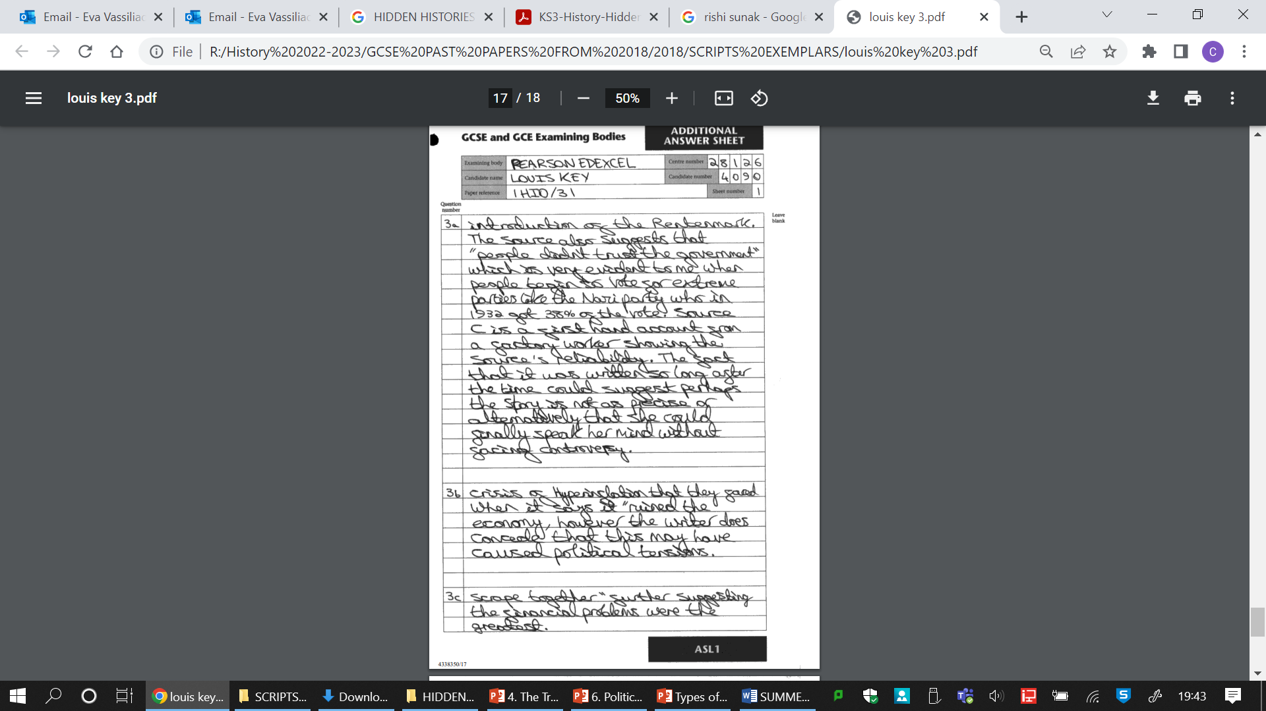
Level/ Mark | Utility… Criteria Analysis and evaluation of source utility AO3
Level 1 (1-2 marks) | A simple judgement on utility is given and supported by undeveloped comment on the content of the sources and/or their provenance. Simple understanding of the source shown by picking out, repeating or summing up. (quote or paraphrase used) Limited own knowledge and some links to the sources.
Level 2 (3-5 marks) | Judgement on how useful the sources are using some criteria (e.g. accuracy, completeness or objectivity) is made. Some analyses/explanation of the source content using quotes and description Using some own knowledge to evaluate the source and/or provenance (NOP). Own knowledge sometimes directly links to the usefulness and/or provenance.
Level 3 (6-8 marks) | Clear judgement on how useful the sources are using clear criteria (e.g. accuracy, completeness, objectivity) is explained. It is supported with clear inferences about the content which is analysed well to argue about how useful the source is Own knowledge used to evaluate. The impact of the provenance (NOP) on the content is explained.
Notes:
8 marks

Slide 15


