Slide 1
Home Learning
You are going to write a letter home from the trenches. Use the information you have gathered to help.
Some of the areas to cover:
Trench
Self inflicted wounds
Boredom
Trench Foot
Casualties
Rats
Lice
Diet
Entertainment
Vocabulary that may be useful:
Awful Hunger Stench
Decaying Horrendous Terrible
Barbarous Hopeless Gruesome
Phrases you could adapt to use:
“I will never forget these terrible conditions…”
“The trench is horrible, but it gives us somewhere to rest…”
Dear..., They say that war is just like a big picnic but I think that it is like hell on earth. I am on the Western Front in a front line trench……

Slide 2
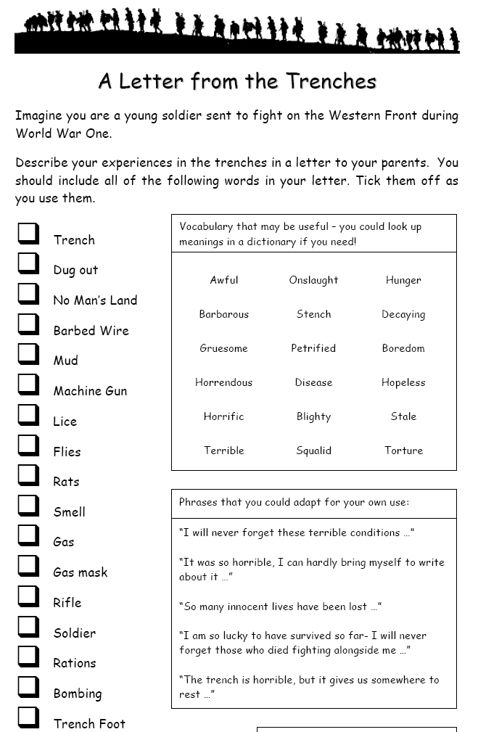
Letter from the Trenches

Slide 3

1st Battalion, Worcester & Sherwood Foresters Fricourt Belgium Sept. 5th 1916
To My Dearest Elsie, I know this is my 5th letter in 3 days but I need to tell the truth. I joined the army for adventure and the chance to see new places but instead I am living in a mud hole, freezing under constant fear of death. You may laugh and say that I am but whingeing and that I am probably the only scared man here but it's not true. All 5,000 of us are terrified of what may come if we so much as lift our heads into the view of the enemy. Every day I have spent in this trench, we have had shells fired at us. The noise is horrific and the despair in the eyes of many a soldier is evident as another comes over. If and when the shelling stops, many drink or smoke to try relax but you can tell that a few are on the brink of breaking down. Some men have shot themselves in the arm or leg just to have an injury serious enough to get them out of the trenches but not bad enough to kill them. Apart from the threat of having your head blown off, the Germans are now trying to gas us to death. These gas attacks are few and far between but when one is launched the new recruits drop like flies mainly because they do not know anything. One called Jenkins lost his gas mask and when the Germans launched a chlorine gas shell, well, that was it for him really. The vile stuff burns your lungs out. The newbies can do nothing but choke up their burnt out lungs. The other gas they use is mustard gas which is truly evil. It blisters the skin, blinding men who then roll around in agony, clutching their red raw flesh. Forgive me if I am scaring you but I need to talk about this. Our daily food is bully beef. When you first start the army and you are eating this you think it's bland but edible. After 3 months of bully beef and little else, you wonder whether you would actually feel better hungry or with a tin of bully beef inside you. Everyone is given some rum to start the day off which is rather uplifting for most of us. Smoking is allowed in the daytime which takes away the taste of bully beef but at night we aren't allowed as the cigarette light makes us an easy target for a German spy. Tea is freely available but the trouble is that it often freezes in your cup as it is so cold. We aren't allowed coats as our superiors say that we won't be able to walk properly in them so frostbite is common. We wear as many layers of clothing as possible which means that our clothes are dirty and sweaty. Men in the front line can't wash until we are sent back to support or reserve. It's made doubly worse by the mud. The mud is probably the worst aspect or rather what comes with it. The mud is oten knee deep. We have to eat, sleep and fight in piles of the stuff. Putees are no use (that's slang for material wrapped around your shins). Do you remember little Billy Rawlson? He drowned in the mud. He was sleeping and his head went under. By the time we noticed he wasn't perched up where he normally was, he was dead. Send Betty my commiseration's and apologies.

Slide 4
The mud brings trench foot with it. Trench foot is where your feet swell up to sometimes double their original size. To start off with, you lose all feeling in your feet. Someone who had trench foot stuck his bayonet into the afflicted foot and didn't even flinch! After a few days of having numb feet, the sensitivity comes back - with a vengeance. Men will often have the foot amputated rather than endure the terrific pain that ensues. Trench foot isn't the only illness that is rife amongst soldiers but Dysentery (stomach pains and diarrhoea), Nephritis (kidney inflammation) and VD are very common and, due to the nature of the illness, it makes life here even more difficult even if you yourself don't suffer from the illness. Every single man in this trench has lice of some variety. This may sound disgusting but hunting out lice becomes almost a social pastime. We search for each other's lice and crush them between our fingernails or burn them with our candles but somehow I doubt "chatting" will catch on back home. Tabby would be happy here. Since there are no cats here, rats run rife. We call them "corpse rats" because these rats will eat the bodies of the dead on the battlefield. Even injured soldiers have found these infernal creatures nibbling his wounds. There have been reports of rats as big as cats about 3 miles up the trench. That would be a great trophy for the soldier that killed it. Part of what annoys me about the army is how men lose their minds to the generals after a few weeks of training but then how they almost reawake once they're in the thick of it all. To be quite frank, it all disgusts me. The battlefield is nearly as muddy as the trenches but with double the horrors. Masses of bodies are piled up out of the way whilst the rats feed upon the corpses. To step onto that field is death and every night this week that is what we have been sentenced to. The commander sounds his whistle, always at night, and we climb over. We run over the field and then you notice your mates falling to the ground around you. The first time it happened, I thought that the commander had shouted an order and I'd missed it so I lay down too but then I realised that their eyes were shut and they weren't breathing anymore. I haven't been shot yet but surely it'll happen to me and then who knows if I'll be alive to tell the tale. After we attack, the Germans will attack us, with their bayonets attached to their guns just as ours had been and like us they will fall. Everyone hates that old butcher Haig. I tell you Elsie, I'd like to see his face if he saw what hell he puts innocent men through. Please, show this letter to everyone you know who is considering joining the army. Let them know what it's really like.
Love, as always Jim

Slide 5
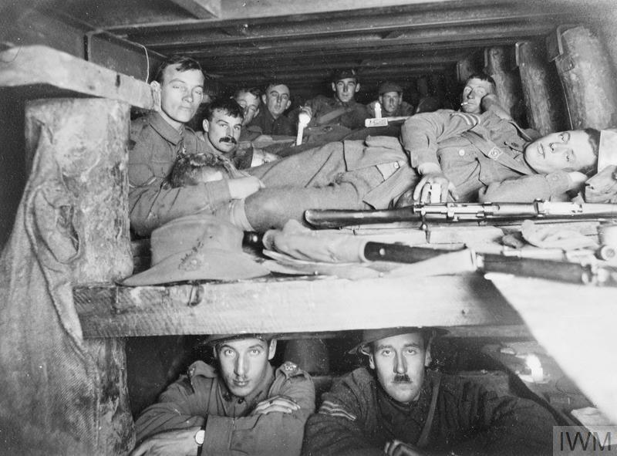
What was it really like in the trenches?
Home Learning Information Booklet

Slide 6
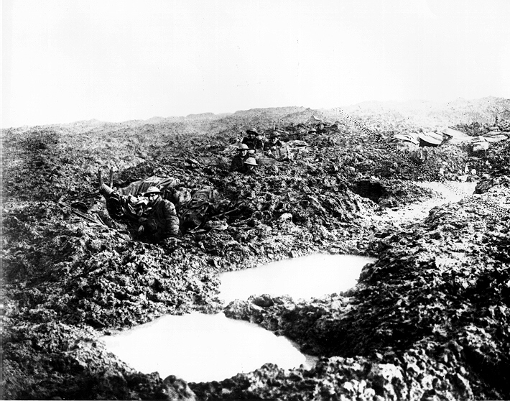
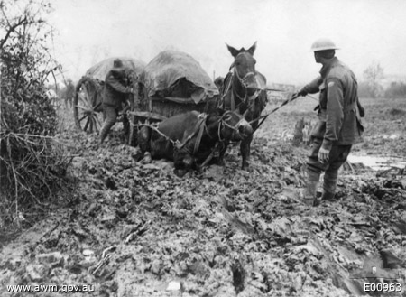
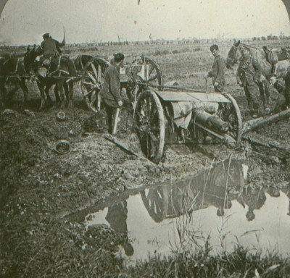
Weather
25/10/1914 – 10/03/1915 only 18 days without rain
Mud was the enemy!
Winter 1914/15 -15 men from British Guards Battallion drowned in mud.
Movement was impossible.

Slide 7
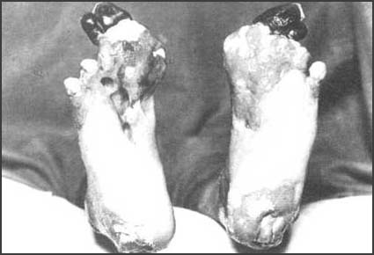
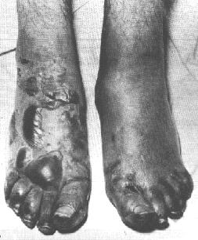
Trench foot – 75,000 cases in British army.
Trench foot
This was an infection of the feet caused by cold, wet and insanitary conditions. In the trenches men stood for hours on end in waterlogged trenches without being able to remove wet socks or boots. The feet would gradually go numb and the skin would turn red or blue. If untreated, trench foot could turn gangrenous and result in amputation.
The only remedy for trench foot was for the soldiers to dry their feet and change their socks several times a day. By the end of 1915 British soldiers in the trenches had to have three pairs of socks with them and were under orders to change their socks at least twice a day. As well as drying their feet, soldiers were told to cover their feet with a grease made from whale-oil. It has been estimated that a battalion at the front would use ten gallons of whale-oil every day.
Sergeant Harry Roberts
“If you have never had trench foot described to you, I will explain. Your feet swell to two to three times their normal size and go completely dead. You can stick a bayonet into them and not feel a thing. If you are lucky enough not to lose your feet and the swelling starts to go down, it is then that the most indescribable agony begins. I have heard men cry and scream with pain and many have had to have their feet and legs amputated. I was one of the lucky ones, but one more day in that trench and it may have been too late.”

Slide 8
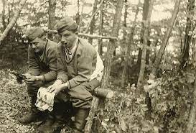
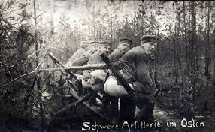
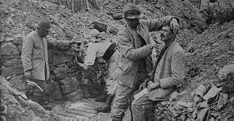
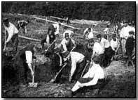
Insanitary conditions
Examples of the lack of hygiene were that the men could not wash while they were in the trenches as there was limited access to running water.
A lavatory (or latrine) often consisted of a large bucket in a side trench.
However, this was a very vulnerable position to be in as the enemy could sneak up behind the unwitting soldier while he was 'occupied'.
Soldiers who were aware of this danger in the trenches would sometimes opt instead for the 'in the hat' method. Due to the cramped conditions, and the constant upheaval of land from shelling, dysentery was a common ailment too.
No washing or shaving here, and the demands of nature answered as quickly as possible in the handiest and deepest shell-hole. - Guy Chapman, from Vain Glory
Under fire men would use nearest crater.
In the British army 2 ‘ shit wallahs ’ were attached to every unit to dispose of urine and ‘Dan the sanitary man’ came down each day spraying creosote as disinfectant.

Slide 9
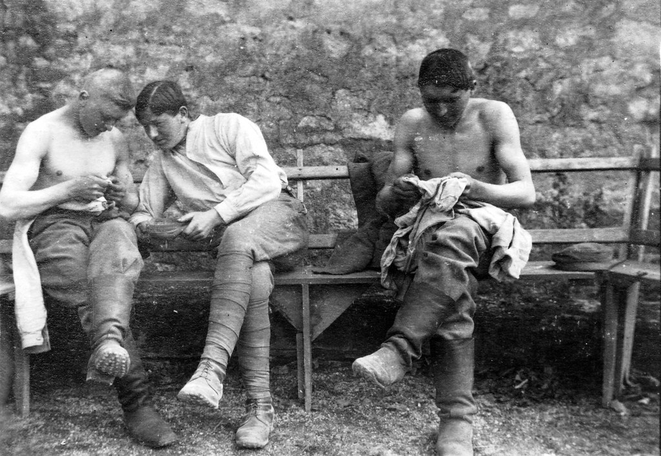
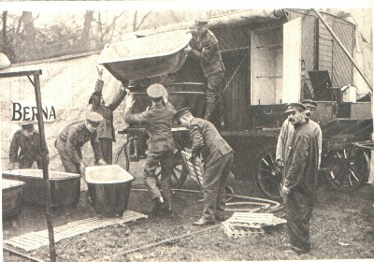
Lice and Trench fever
Trench fever is a blood-borne infection caused by a bacterium known as Bartonella quintana.
The symptoms are similar to influenza, with increased pain and a high fever and only rest, usually away from the front-line, could assure that the condition could be treated.
Full recovery usually took up to twelve weeks, but because the pesky lice were not actually identified as the culprits of Trench Fever until 1918, some men it was assumed, had just a high fever associated with another illness.
As such, many died from the disease whilst recuperating away from the trench due to inadequate medical treatment.
Lice hunting was called 'chatting'. In parcels from home it was usual to receive a tin of supposedly death-dealing powder or pomade, but the lice thrived on the stuff.
Private George Coppard, from With A Machine Gun to Cambrai
The other soldiers in the hut took their shirts off after tea. They were catching lice. We had never seen a louse before, but they were here in droves. The men were killing them between their nails.
Henry Gregory

Slide 10
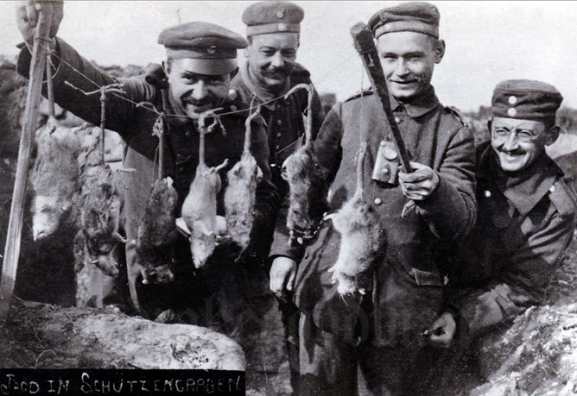
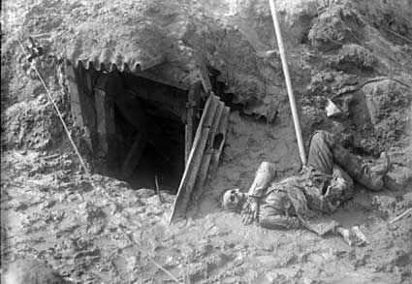
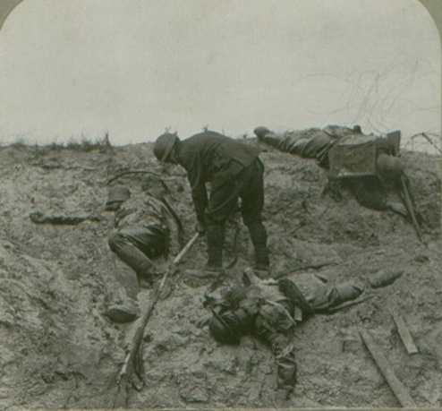
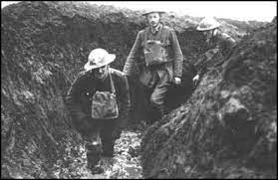

The dead
The number of human
corpses made disease inevitable!
The stench of the dead bodies now is awful as they have been exposed to the sun for several days, many have swollen and burst. The trench is full of other occupants, things with lots of legs, also swarms of rats.
Sergeant Vine
Most dead were buried where they fell
Later the War Graves Commission re-buried them in the graves you can still see today
Thousands had no grave-they were never found!
Frogs also made their way into trenches. Normally found in shell holes filled with water, they thrived in the base of trenches and could cause a man to slip and fall.
Normally this wasn't such a problem, but if a fellow soldier just happened to be sharpening his bayonet and you slipped on a frog and fell on him, you could end up with a nasty case of stabbing.

Slide 11
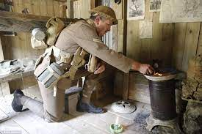
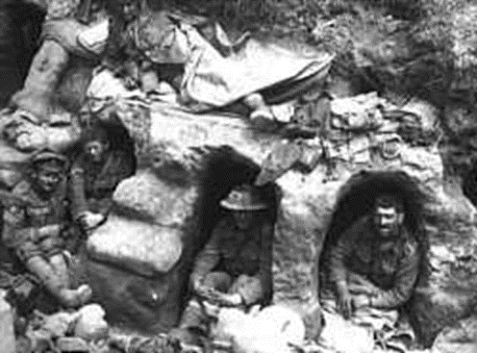
Boredom
A soldier’s life in the trenches was spent not so much in fighting but in an endless exhausting physical labour.
The day began and ended with a ‘stand to ‘ in case the enemy chose to make a dawn or dusk attack.
The rest of the day was spent doing ‘watches’ like sentry duty on the fire step.
Fatigues = digging and repairing trenches, fetching rations and stores.
Trying to get some sleep in a dug out (see below)
Busiest time was at night when the men also repaired the barbed wire and patrolled No Man’s Land to observe the enemy and rescue the wounded.
Men might have different experiences of life on the Western Front depending on their rank and role.
For example, it was the job of the Officer to lead night patrols, to organise the men and to relay orders from High Command.
It is said that they were treated better than ordinary soldiers as they had small 'dug-outs' in trenches where they would eat and sleep, better food and might be more readily excused from front line duty if they were wounded or ill.

Slide 12
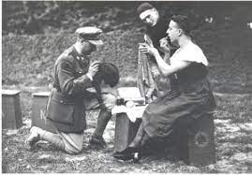
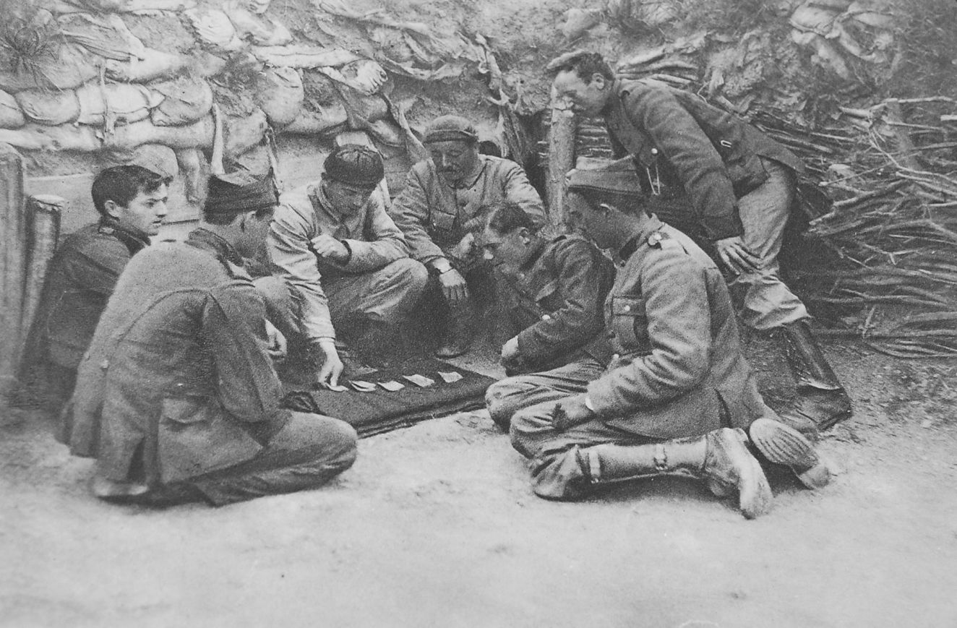
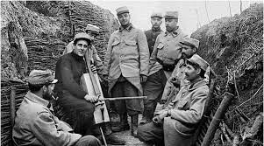
ENTERTAINMENT
A few miles behind the lines:
Inter unit football matches
Boxing matches between divisions
Pantomimes
Music shows
Visit local village with a pass to buy souvenirs or play cards all night.

Slide 13
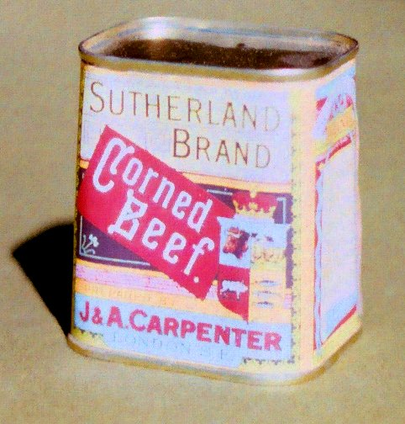
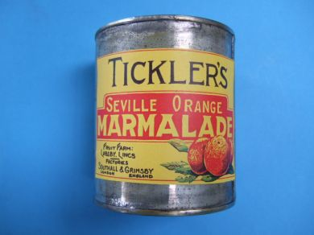
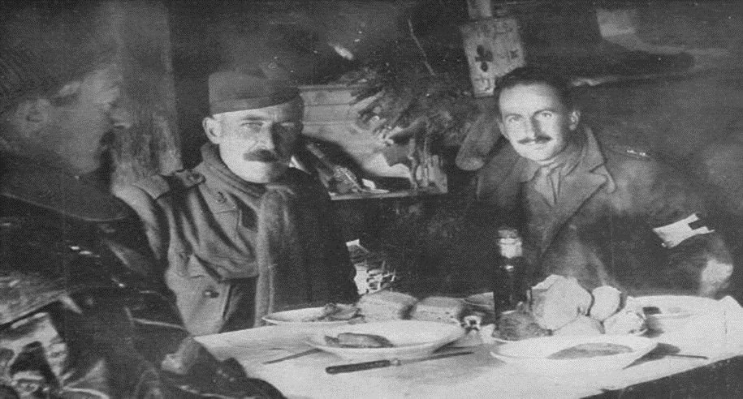
Diet
British Daily Ration - 1914
20 oz. Fresh or frozen meat, or 16 oz. preserved or salt meat
20 oz. bread, or 16 oz. biscuit or flour
4 oz. bacon
3 oz. cheese
5/8 oz. tea
4 oz. jam
3 oz. sugar
1/2 oz. salt
1/36 oz. pepper
1/20 oz. mustard
8 oz. fresh or 2 oz. dried vegetables
1/10 gill lime juice if vegetable not issued (for scurvy )
1/2 gill rum (at discretion of commanding general)
not to exceed 20 oz. tobacco per week
All we lived on was tea and dog biscuits. If we got meat once a week we were lucky, but imagine trying to eat standing in a trench full of water with the smell of dead bodies nearby.
Richard Beasley
In a letter to his parents, Private Pressey of the Royal Artillery described the quality of the food men were receiving on the Western Front.
“The biscuits are so hard that you had to put them on a firm surface and smash them with a stone or something. I've held one in my hand and hit the sharp corner of a brick wall and only hurt my hand. Sometimes we soaked the smashed fragments in water for several days. Then we would heat and drain, pour condensed milk over a dishful of the stuff and get it down”

Slide 14
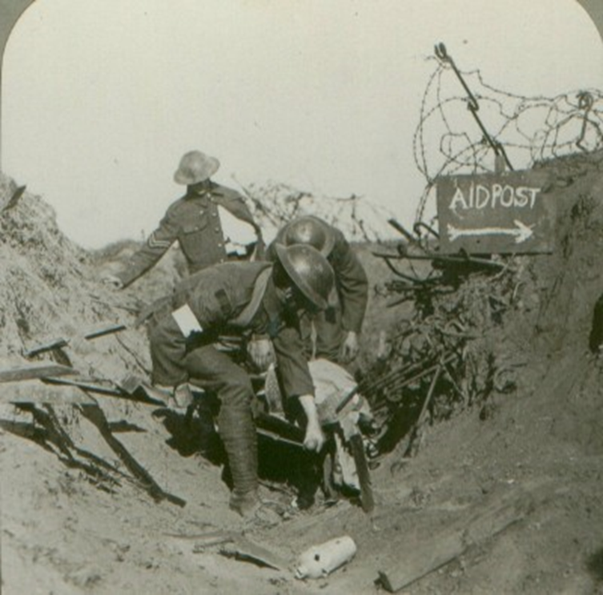
Injuries
Lesley Smith worked as a VAD at the Royal Sussex Hospital in Brighton during the early stages of the First World War. Later she was posted to a field hospital on the Western Front.
“Day after day we cut down stinking bandages and exposed wounds that destroyed the whole original plan of the body. One man had both buttocks blown off, one arm had been amputated at the elbow, and he had a host of smaller wounds from flying metal. Another lay propped on moss to absorb the puss from two large holes in each thigh.”
The other one said to me “ Chas, I am going home to my wife and kids. I’ll be some use to them as a cripple, but none at all dead! I am starving here, and so are they at home, we may as well starve together.” With that he fired a shot through his boot. When the medics got his boot. When the medics got his boot off, two of his toes and a lot his foot had gone. But the injuring oneself to get out of it was quite common.
Charles Young
The nickname for England was “Blighty”
Soldiers called a wound that would get them out of the trenches and back to England - a “Blighty Wound”
Some actively tried to suffer such a wound

Slide 15
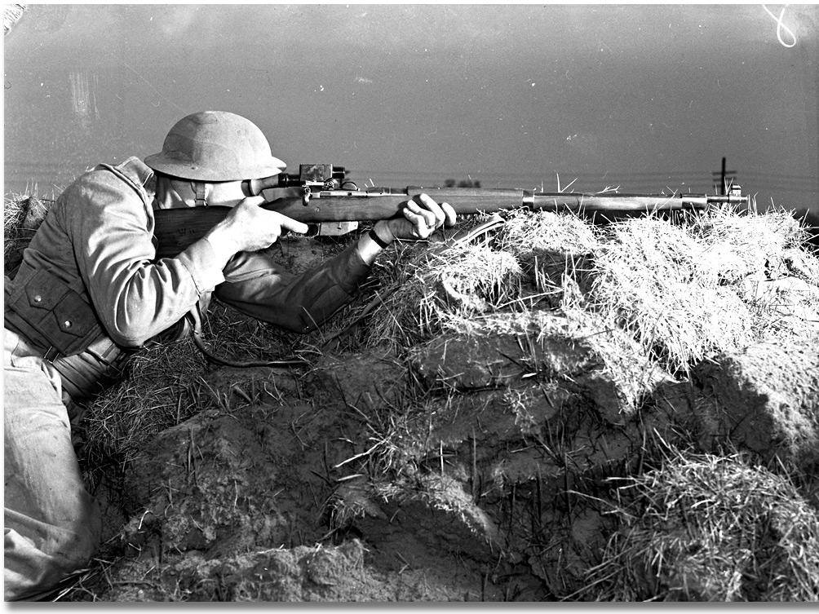
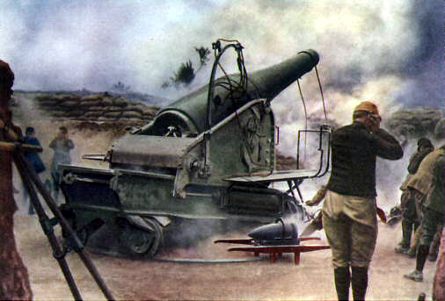
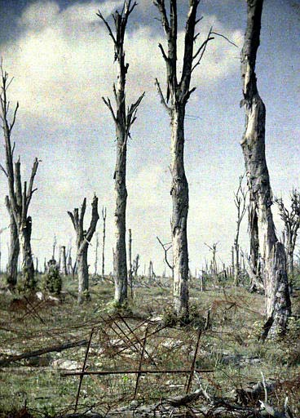
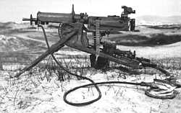
Weapons
Rapid advancements
Germans more innovative- 1914 first to use machine guns, flame throwers, chlorine gas (1915 Ypres) and snipers
The machine gun was king of the battlefield
MGs could fire 500 rounds per minute-the same firepower of 100 rifles
As machine guns could shoot hundreds of rounds of ammunition a minute and the standard military tactic of World War One was the infantry charge it led to huge causalities and deaths. Many soldiers barely got out of their trench before they were cut down.
MGs helped cause the stalemate.
Bullets were now designed with a more pointed shape which drove them deeper into the human body.
The successor to the cannon grew bigger and more powerful throughout the war – the British developed a howitzer which could send 900kg shells over a distance of 12 miles
Bombardments were no longer short-lived; they could last weeks and months
Artillery fire was the greatest killer of all weapons, causing half of all causalities
Notes:
https://www.bbc.co.uk/teach/class-clips-video/history-ks3-ks4-i-was-there-the-great-war-interviews-shell-shock/zkypy9q
Tanks: https://www.bbc.co.uk/programmes/b082hygg

Slide 16
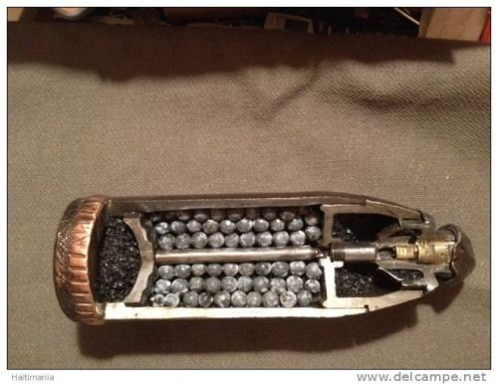
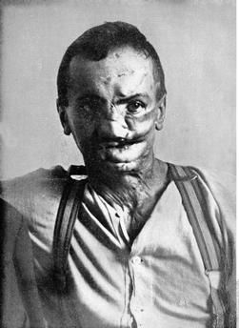
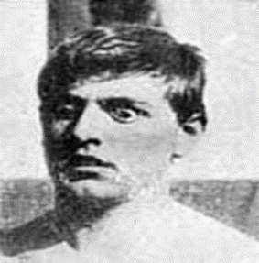
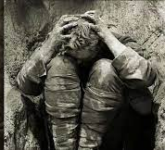
Shrapnel and Shell shock (PTSD)
Shrapnel consisted of a hollow shell which was packed with steel balls or lead, together with gunpowder and a timer fuse.
It was designed to explode in mid-air above the enemy, causing maximum casualties.
It was effective against troops advancing across open land.
By the end of World War One the British Army had dealt with 80,000 cases of shell shock
Results from the stress of battle which decrease the soldier’s fighting efficiency. The most common symptoms are fatigue, slower reaction times, indecision, disconnection from one's surroundings, and inability to prioritize.
Notes:
https://www.bbc.co.uk/teach/class-clips-video/history-ks3-ks4-i-was-there-the-great-war-interviews-shell-shock/zkypy9q

Slide 17
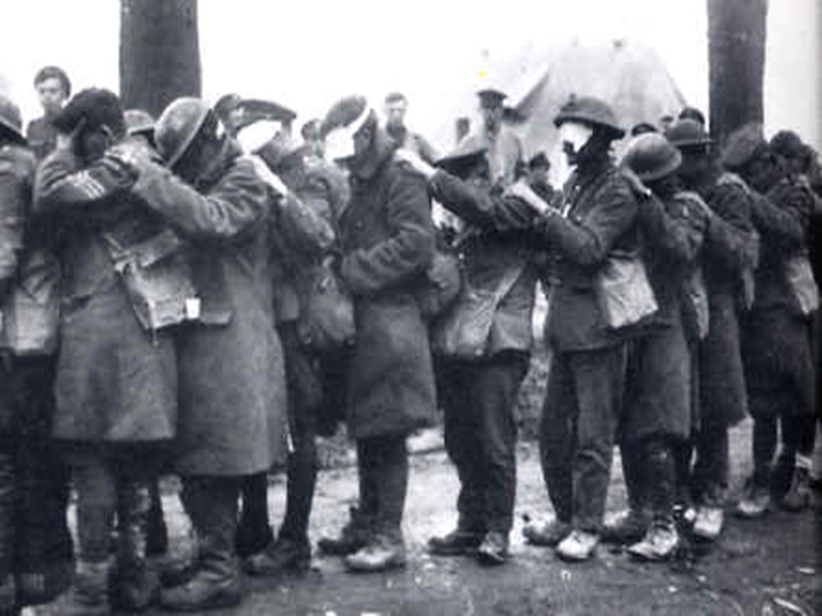
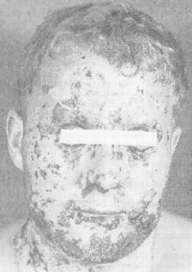
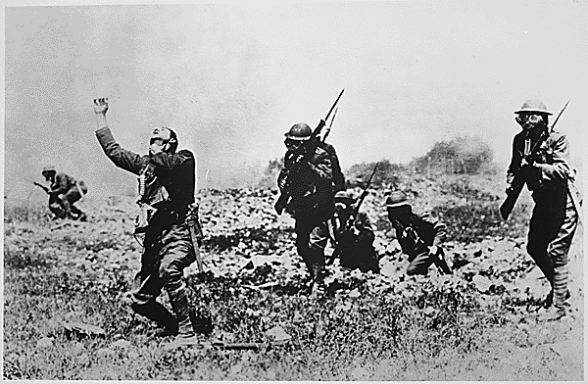
Gas!
Mustard gas was first used by the Germans against the Russians at Riga in September 1917. This gas caused both internal and external blisters on the victim within hours of being exposed to it. Such damage to the lungs and other internal organs were very painful and occasionally fatal. Many who did survive were blinded by the gas.
Chlorine gas had a yellowish colour, it destroyed the respiratory organs of its victims and this led to a slow death by suffocation.
Gas was the most feared weapon. Death was not instant and could be agonising. It could be used when no attack was happening. It killed men after the war too e.g. Emphysema.
Phosgene was especially potent as its impact was frequently felt only 48 hours after it had been inhaled and by then it had already bedded itself in the respiratory organs of the body and little could be done to eradicate it. Also it was much less apparent that someone had inhaled phosgene as it did not cause as much violent coughing. By the time that phosgene had got into a person's bodily system, it was too late.
Notes:
https://www.youtube.com/watch?v=H9dgQTM28pM

Slide 18
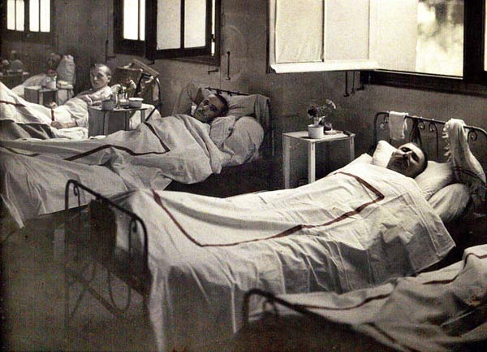
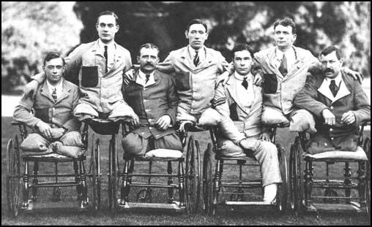
Treatment
Stretcher bearers- removed the dead and wounded
Regimental Aid Post- 200m from the front line. Patched up and got as many as possible back out fighting
Dressing Stations- mile behind front line. Spend one week here and sent back to unit or to:
Casualty Clearing Stations- treated most critical injuries.
Base hospitals
In the filthy conditions blood poisoning and gangrene set in quickly 1/3 of all battle casualties died.
Medical advancements = artificial limbs, plastic surgery and blood transfusions.

