Slide 1

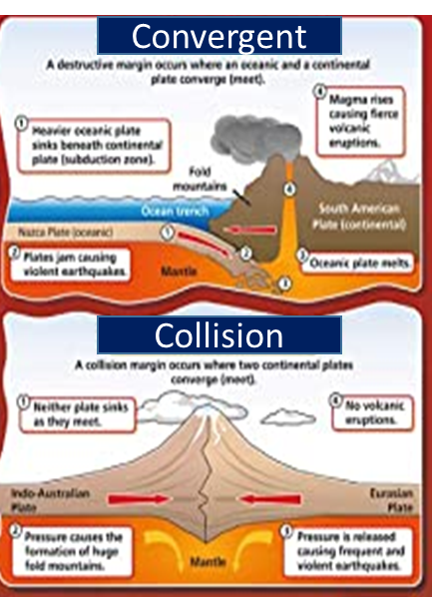
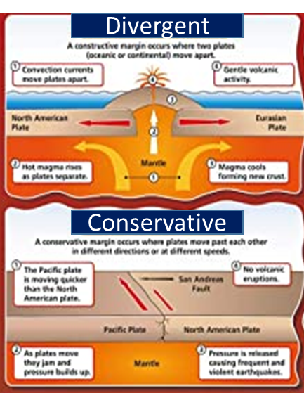
Year- 7 Subject- Geography Topic/Concept – Hazards Term – 2
Key Vocabulary
Word | Definition
Natural Hazard | An extreme natural event that might have a negative effect on humans or the built environment.
Crust | The outermost layer of the planet, consisting of oceanic and continental crust
Mantle | Thickest layer of the Earth, consisting of molten rock (magma)
Convection currents | Circular movements of magma in the mantle which causes the tectonic plates to move
Shield volcano | A volcano with gentle sloping sides
Composite volcano | Steep volcano build up of layers of hardened lava and ash
Supervolcano | Large volcano with a caldera rather than magma chamber. If it erupts it will cause global impacts
Tsunami | A long, high wave caused by an earthquake
Earthquake | A violent shaking of the ground as a result of plate movements
Focus | The location of where the earthquake begins
Epicentre | The point of the earth’s surface directly above the focus
Primary Effect | Effects that happen immediately after the hazard happens e.g.. Heavy rain causes flooding
Secondary Effect | The knock-on effects of the hazard e.g.. Flooding leads to businesses losing money
Immediate response | The actions of people in the hours and weeks following a disaster e.g.. giving out clean water
Long-term response | The actions of people in the months and years following a disaster e.g.. rebuilding
Answering the core questions
What is the difference between divergent and convergent plate margins? Divergent plate margins are plates that are moving apart whereas convergent plates move towards each other. What are the characteristics of a shield volcano? A shield volcano has gentle sloping sides made of lava and a wide base. They have frequent eruptions but are not violent. What are the characteristics of a composite volcano? A composite volcano has tall, steep sides and a narrow base. The lava is sticky and does not flow far. Eruptions are violent. What are the characteristics of a super volcano? A large, bowl-shaped depression in the ground that if erupts will cause massive destruction. Why is the depth of the focus important? A shallow focus earthquake travels a shorter distance, and therefore is more destructive than a deep focus earthquake.
Types of plate margins/boundaries

