Slide 1

Sixth form Transition 2022
The TDA Way
#GoodtoGreat

Slide 2
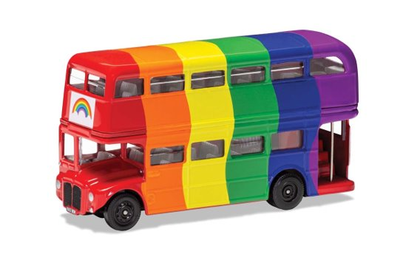



Welcome aboard
@Dukeries6thform
#GoodtoGreat

Slide 3
Mission (Why we exist)
To transform lives by inspiring excellence and maximising opportunities for all.
#GoodtoGreat

Slide 4
Vision (What we aspire to achieve)
Educational Excellence: To be a beacon of inclusive educational excellence which fosters ambition, facilitates great learning, and enables outstanding progress for every student irrespective of their starting point. | Social Mobility and Cultural Capital: To develop ambitious knowledge, character, and cultural capital to empower our students to be bold and courageous change-makers who are equipped to thrive in, and make a positive contribution to, a rapidly changing world.
Our People: To be recognised as an exceptional place to work which attracts, retains, and develops the very best | Our Community: To be the trusted Academy, of choice, at the heart of our community.
#GoodtoGreat

Slide 5
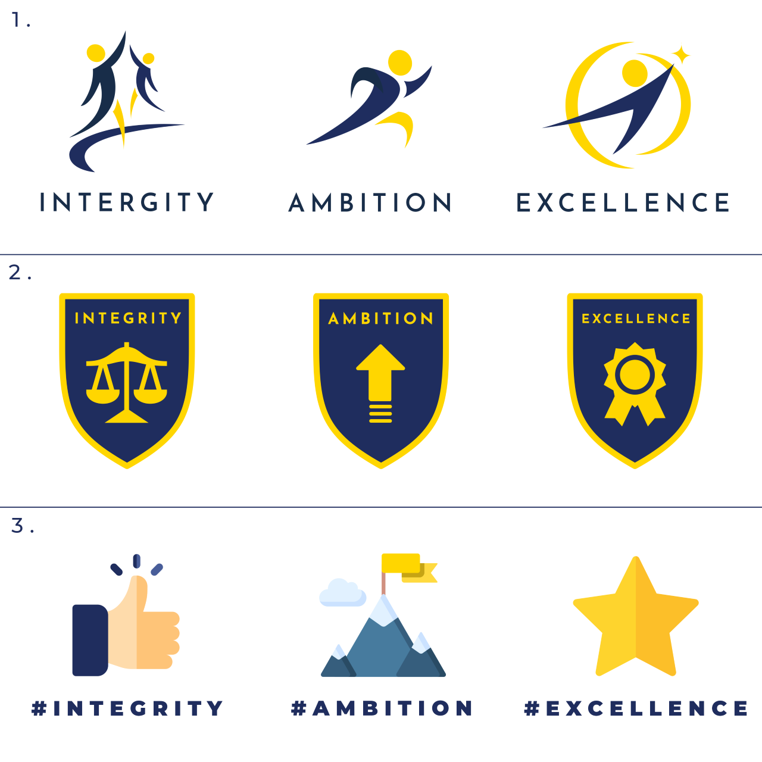
Values (How we act and behave)
INTEGRITY: We have the courage to act with moral and ethical intent. We aspire to be honest and to treat ourselves and others with respect and kindness.
AMBITION: We are passionate about working hard and are optimistic and persistent as we overcome barriers to achieving our aspirations.
EXCELLENCE: We are resolute in our desire to be the very best in everything that we do.
#GoodtoGreat

Slide 6
Good to Great
“Greatness is not a function of circumstance. Greatness, it turns out, is largely a matter of conscious choice.”
Jim Collins
#GoodtoGreat

Slide 7
OFSTED
“Students enjoy studying in the sixth form. They value their established relationships with supportive staff. They learn age-appropriate ways to stay safe through a well planned life skills programme. Most of these students aim to attend university or to secure higher level apprenticeships.” OFSTED Oct 2022
#GoodtoGreat

Slide 8
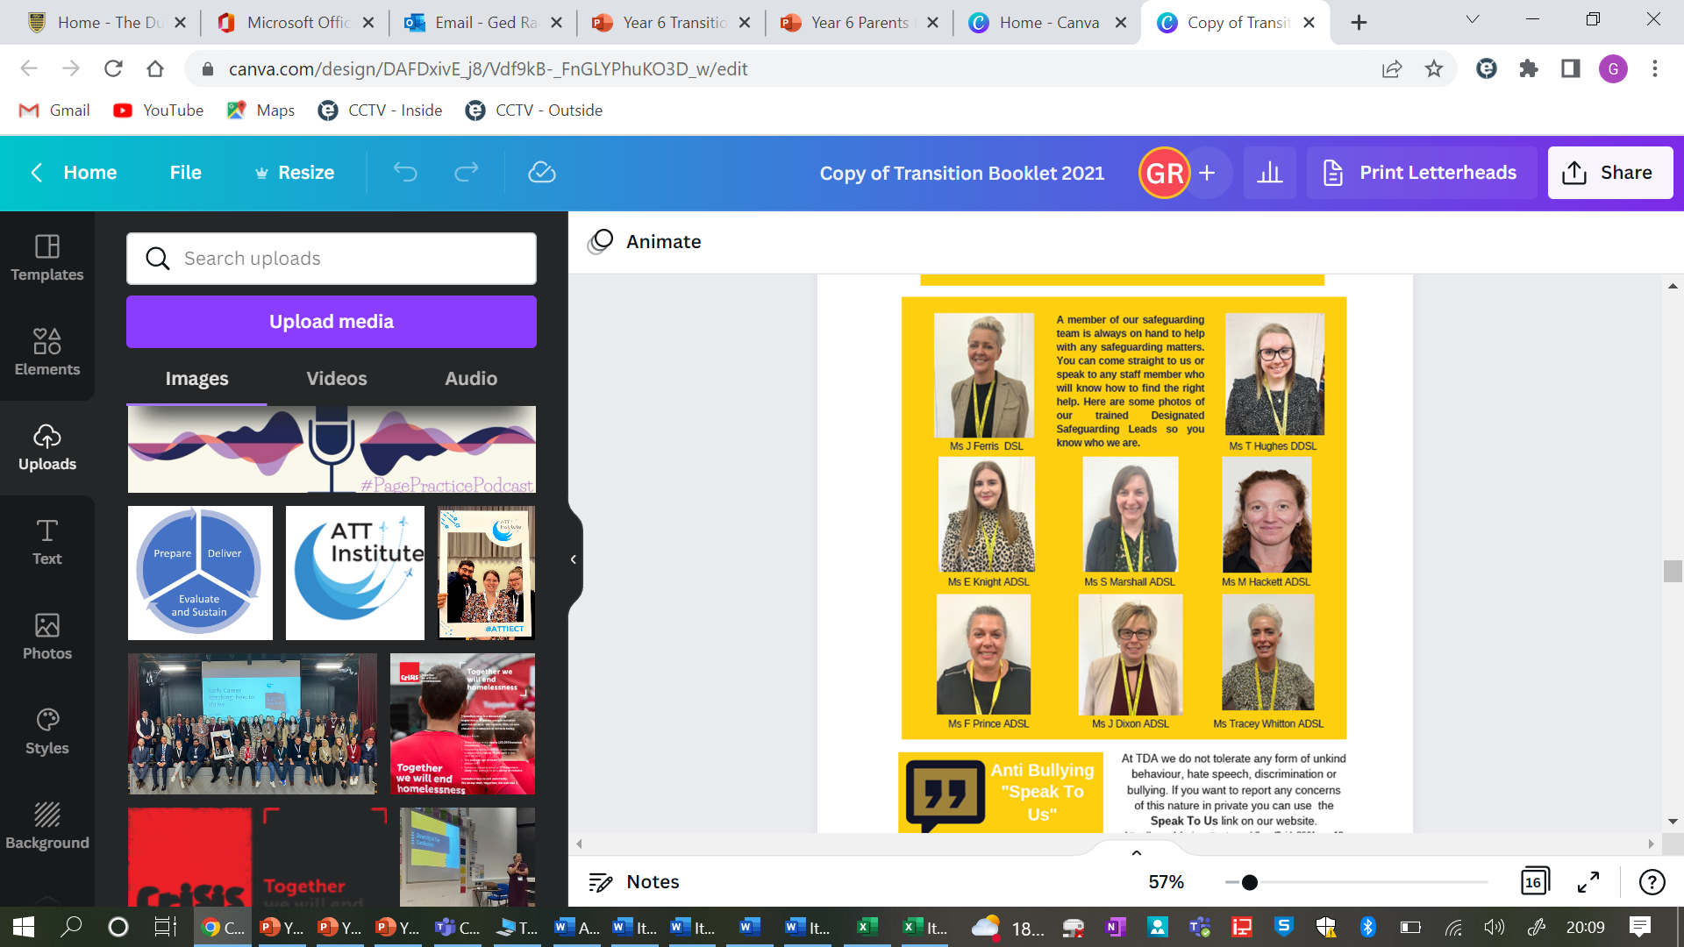
Keeping your child safe
As pupils enter the school, they are reminded of its inclusive culture by crossing the Rainbow Road. The staff know the pupils very well and have their best interests at heart. Pupils say that they are excited to attend this school and feel safe.
Ofsted, 2021
#GoodtoGreat

Slide 9
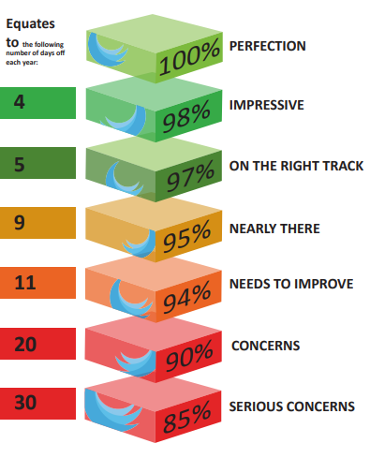
Attendance
Attend every day and on time
Students can fill authorised absence forms themselves they just need to show the evidence of an appointment to their tutor.
#GoodtoGreat

Slide 10


TDA6 Team
Miss Michelle Hackett – Head of Sixth Form
Mr Robson Barrett – UCAS and Careers advisor
Mrs Janette Dixon – KS5 Pastoral Lead
Follow us on twitter
@Dukeries6thform
Our emails
michelle.Hackett@attrust.org.uk
Robson.barrett@attrust.org.uk
Janette.Dixon@attrust.org.uk
#GoodtoGreat

Slide 11
What do we do?
Bespoke, individual support package.
Transition
Bursary
University applications
Pathways – which one is right for you?
1 to 1 careers interviews
50% of this year's Russell Group students hold an offer from top 6 Universities
26% of year 13 students hold RG offers, last year for Nottinghamshire it was 18%
Every Year, for the last 4 we've had offers from Oxbridge
Year 13 - Offer holders for Architecture, Paramedic, Journalism, Motor sport engineering, theatre and social change, accounting and finance, Nursing, Physiotherapy, Teaching
Students have gone on to do degree apprenticeships in Engineering and Finance
Oxbridge acceptance was 3.5 times more than the Nottinghamshire average last year

Slide 12
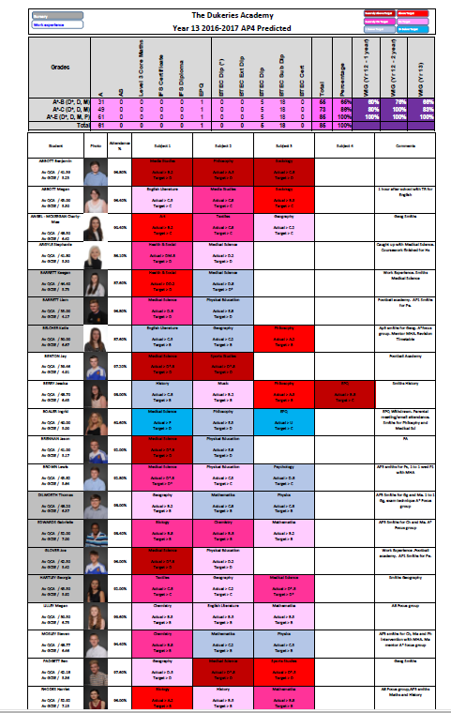
Target setting
We use two things to set targets.
Value Added
ALPS – this is based on the students average point score at GCSE.

Slide 13
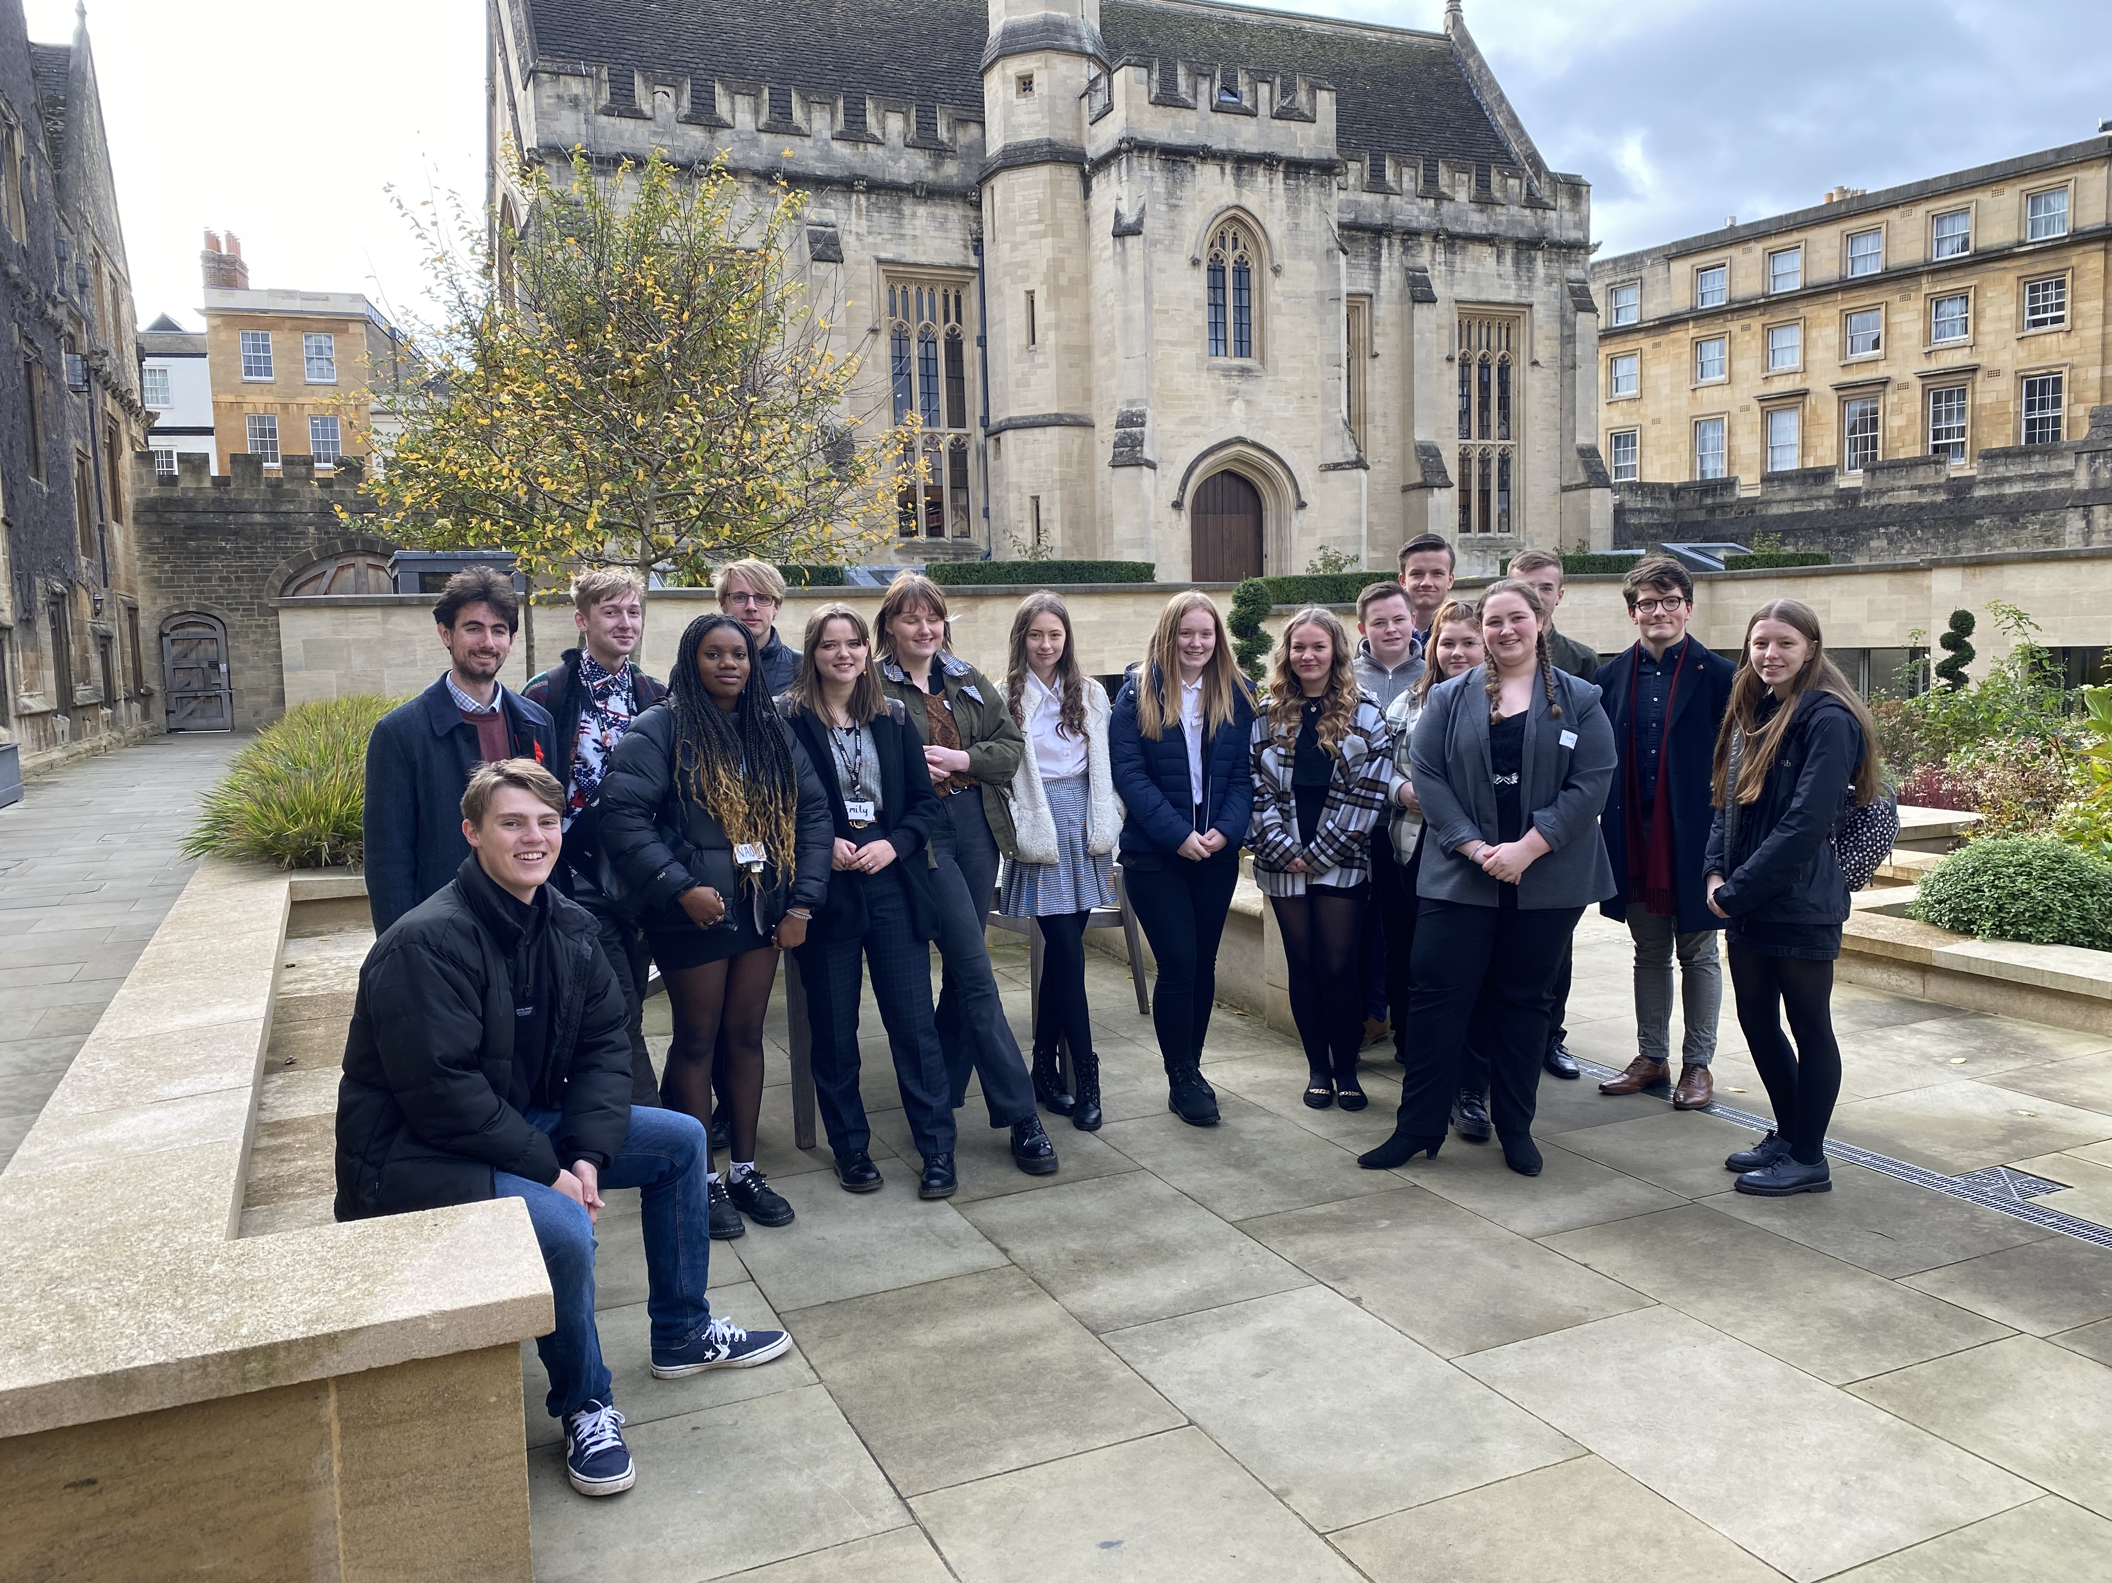
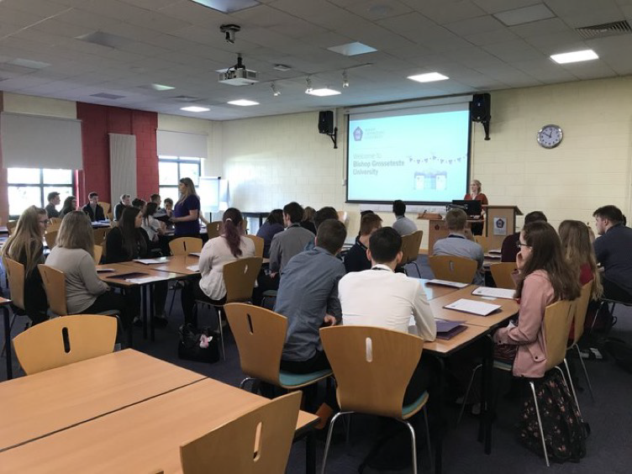
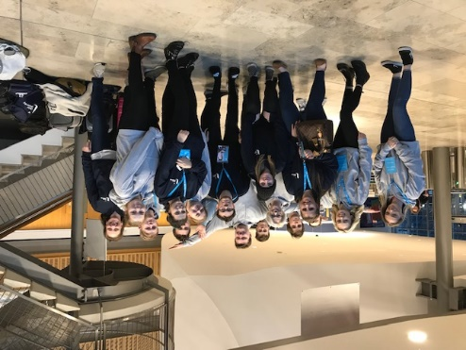
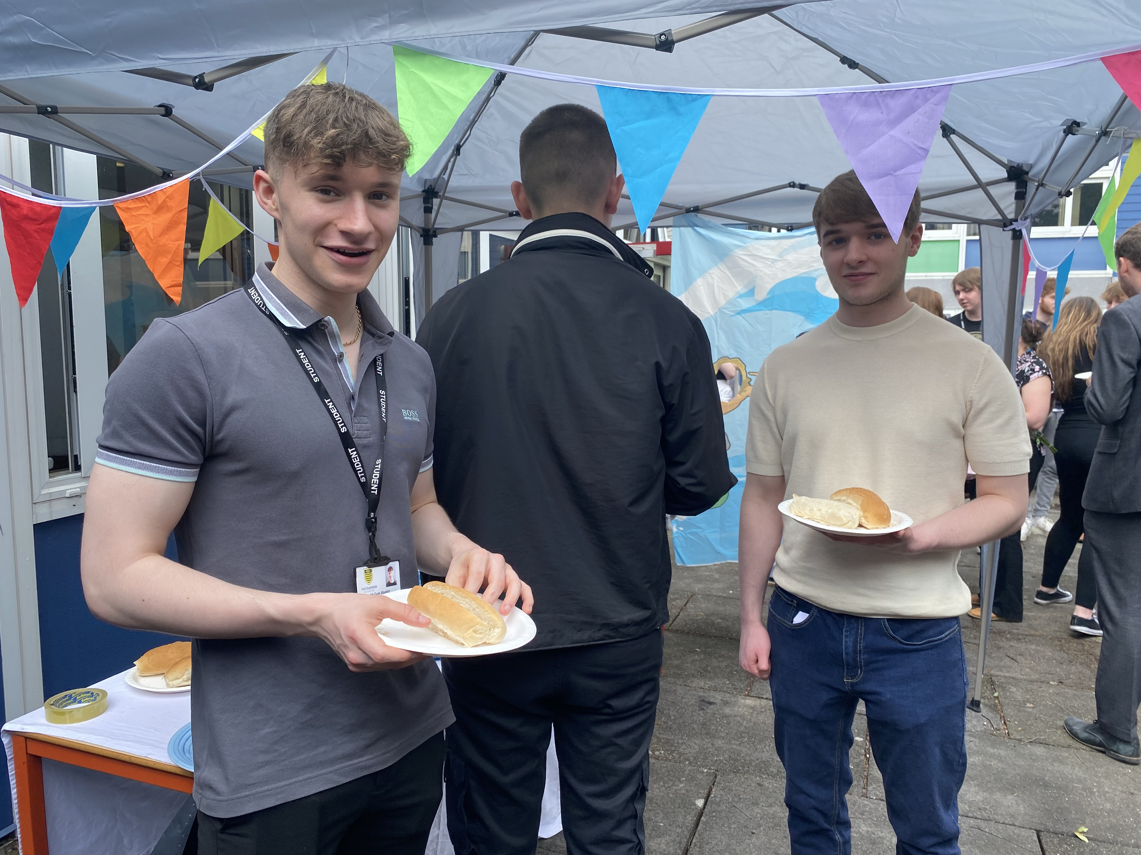
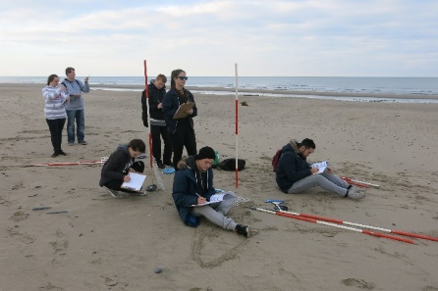
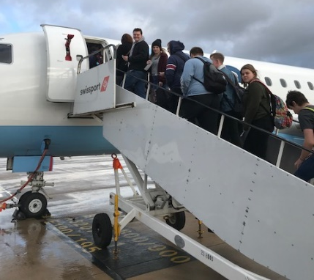
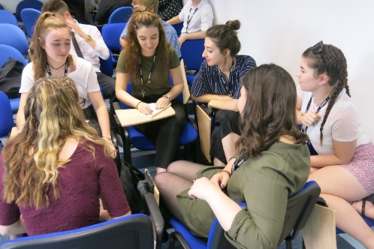
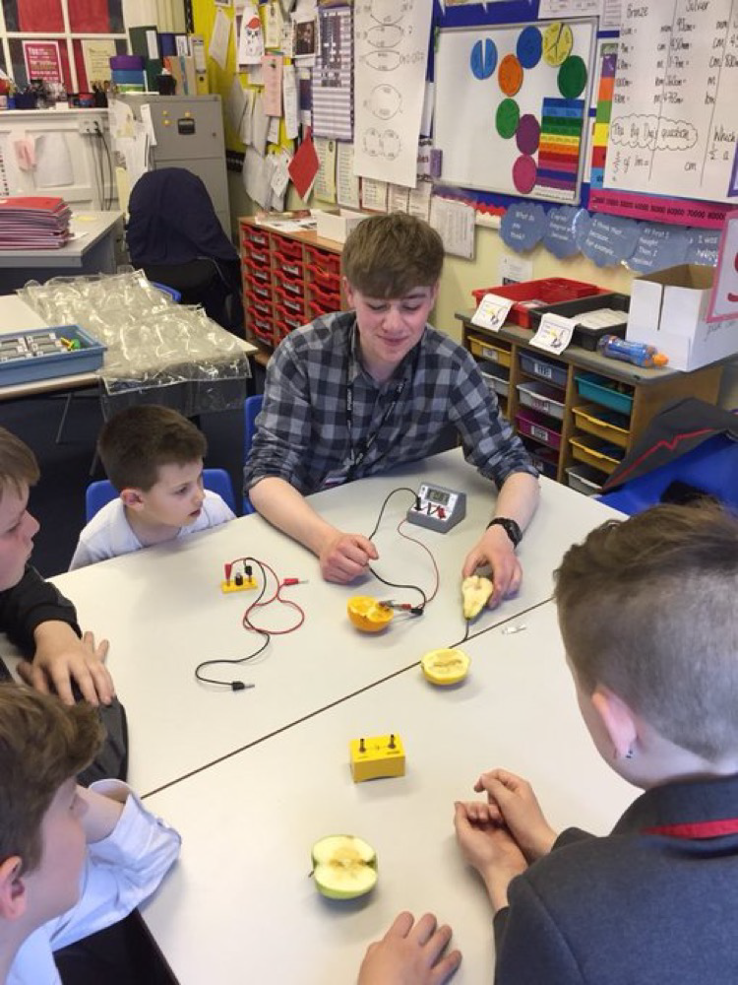
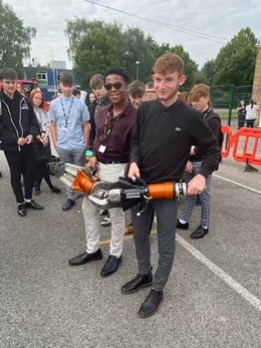
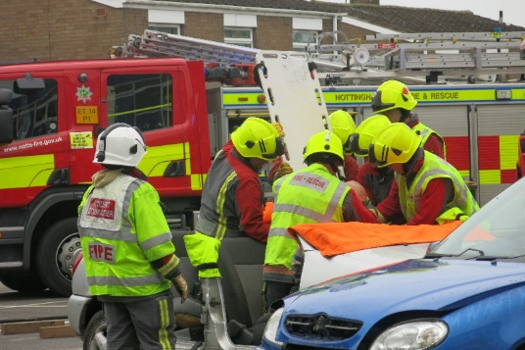
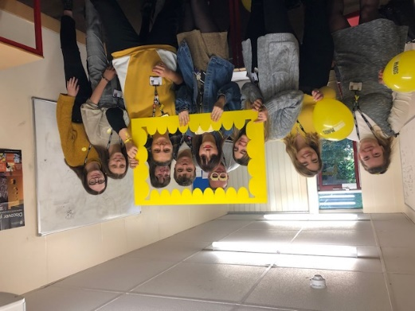
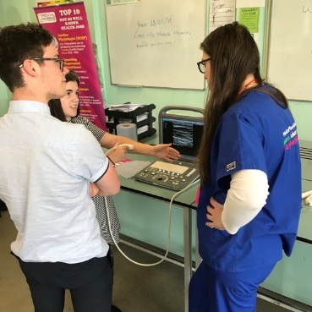
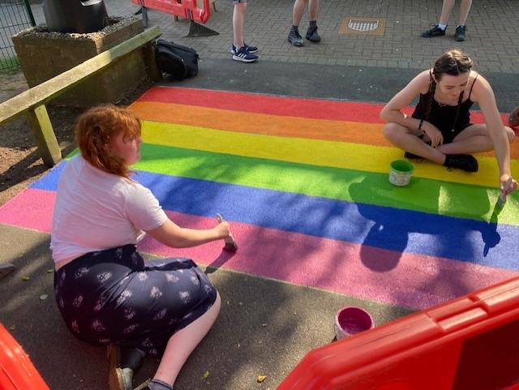
Enrichment
University open days
Subject specific trips – Geography field trip
Ulster trip to Ireland
Socialising events - sixth form BBQ
Work with primary schools to deliver lessons
Team Building activities
RTC day – working with the fire service
Career focus days – Medical Mavericks
Charity work – mental health/ DEI work

Slide 14
Dress Code
The Dukeries Sixth form has a dress code – business wear.
This is in line with the staff dress code and it is to promote a work ethos in the sixth form.
There is no denim – you will be sent home to change if you come to school inappropriately dressed.
Facial piercings must be removed or replaced with clear studs. One nose stud is allowed.
Hoodies are not allowed to be kept on when students are in school. Outdoor coats should also be removed.
You can wear a shirt however a tie is optional. Skirts/ dresses should be knee length.
Footwear must be appropriate – no sandals, canvas shoes, trainers or UGG boots, any other boots should have no more than 10 holes.

Slide 15
Parents As Partners
Students need to understand that there are benefits to moving out of their comfort zones, and they will make mistakes when learning to work independently – encourage this because we learn from our mistakes and failures.
Encourage your son/daughter to sign up for MOOCS. MOOCS are online courses that are offered, free of charge, by universities across the world and will give them a taster of what studying at university is like.
Your child should be tracking what they do know and what they do not know in each of their subjects so they can work on their areas of weakness.
There are many opportunities to enter academic competitions, some of which are run by universities. You could encourage your child to enter these – they look impressive on university and apprenticeship applications.
One important aspect of being an independent learner is knowing when to ask for help – your child should always ask their teacher if they need support.
Encourage your son or daughter to share/discuss the work that they are doing, and the progress they are making. Think about setting an example and signing up for a MOOC that interests you. Check some out on www.futurelearn.com.
Encourage your child to have a tidy space to work in - it can reduce stress and improve productivity. Another way to maximise opportunities for work and reduce distractions is to ensure the space is organised with everything needed for studying: laptop, books, pens and any other equipment.

Slide 16
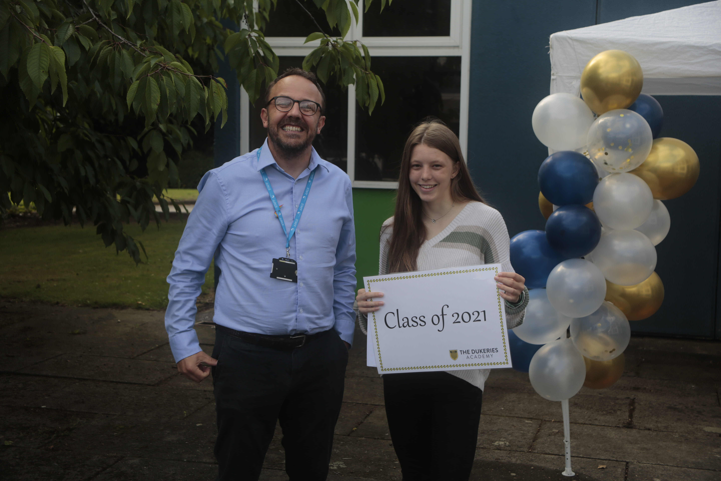
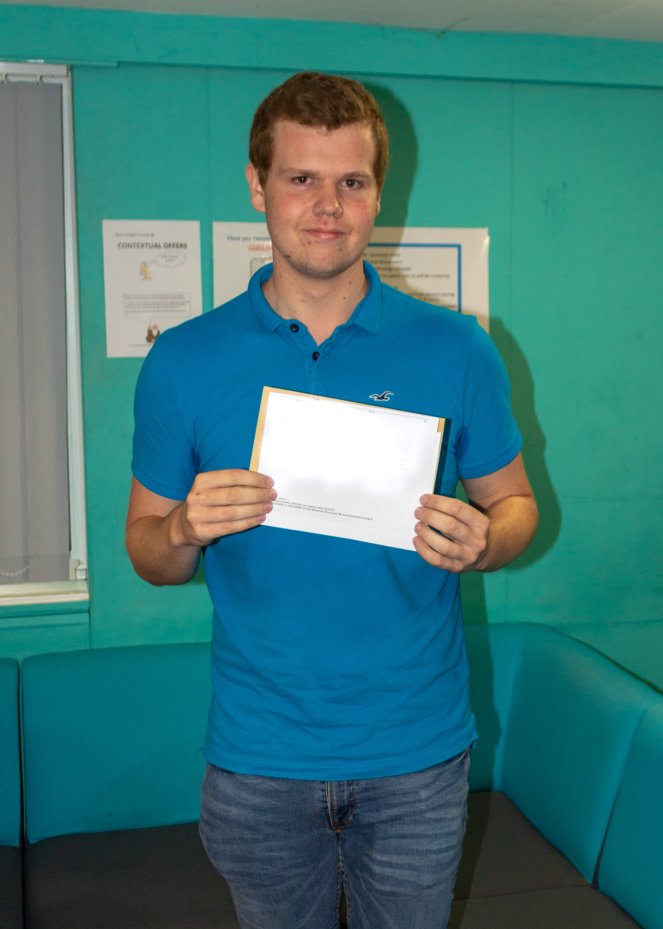
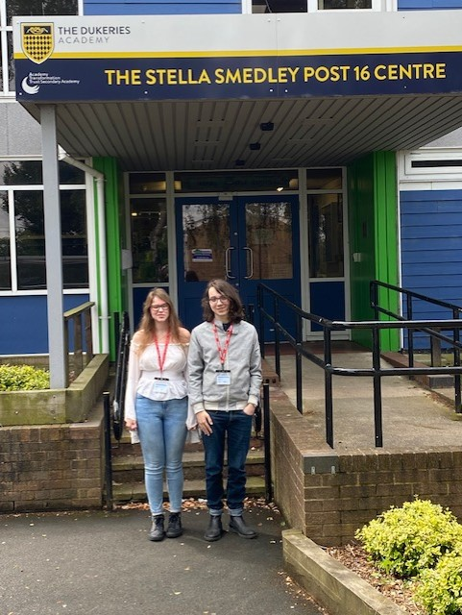
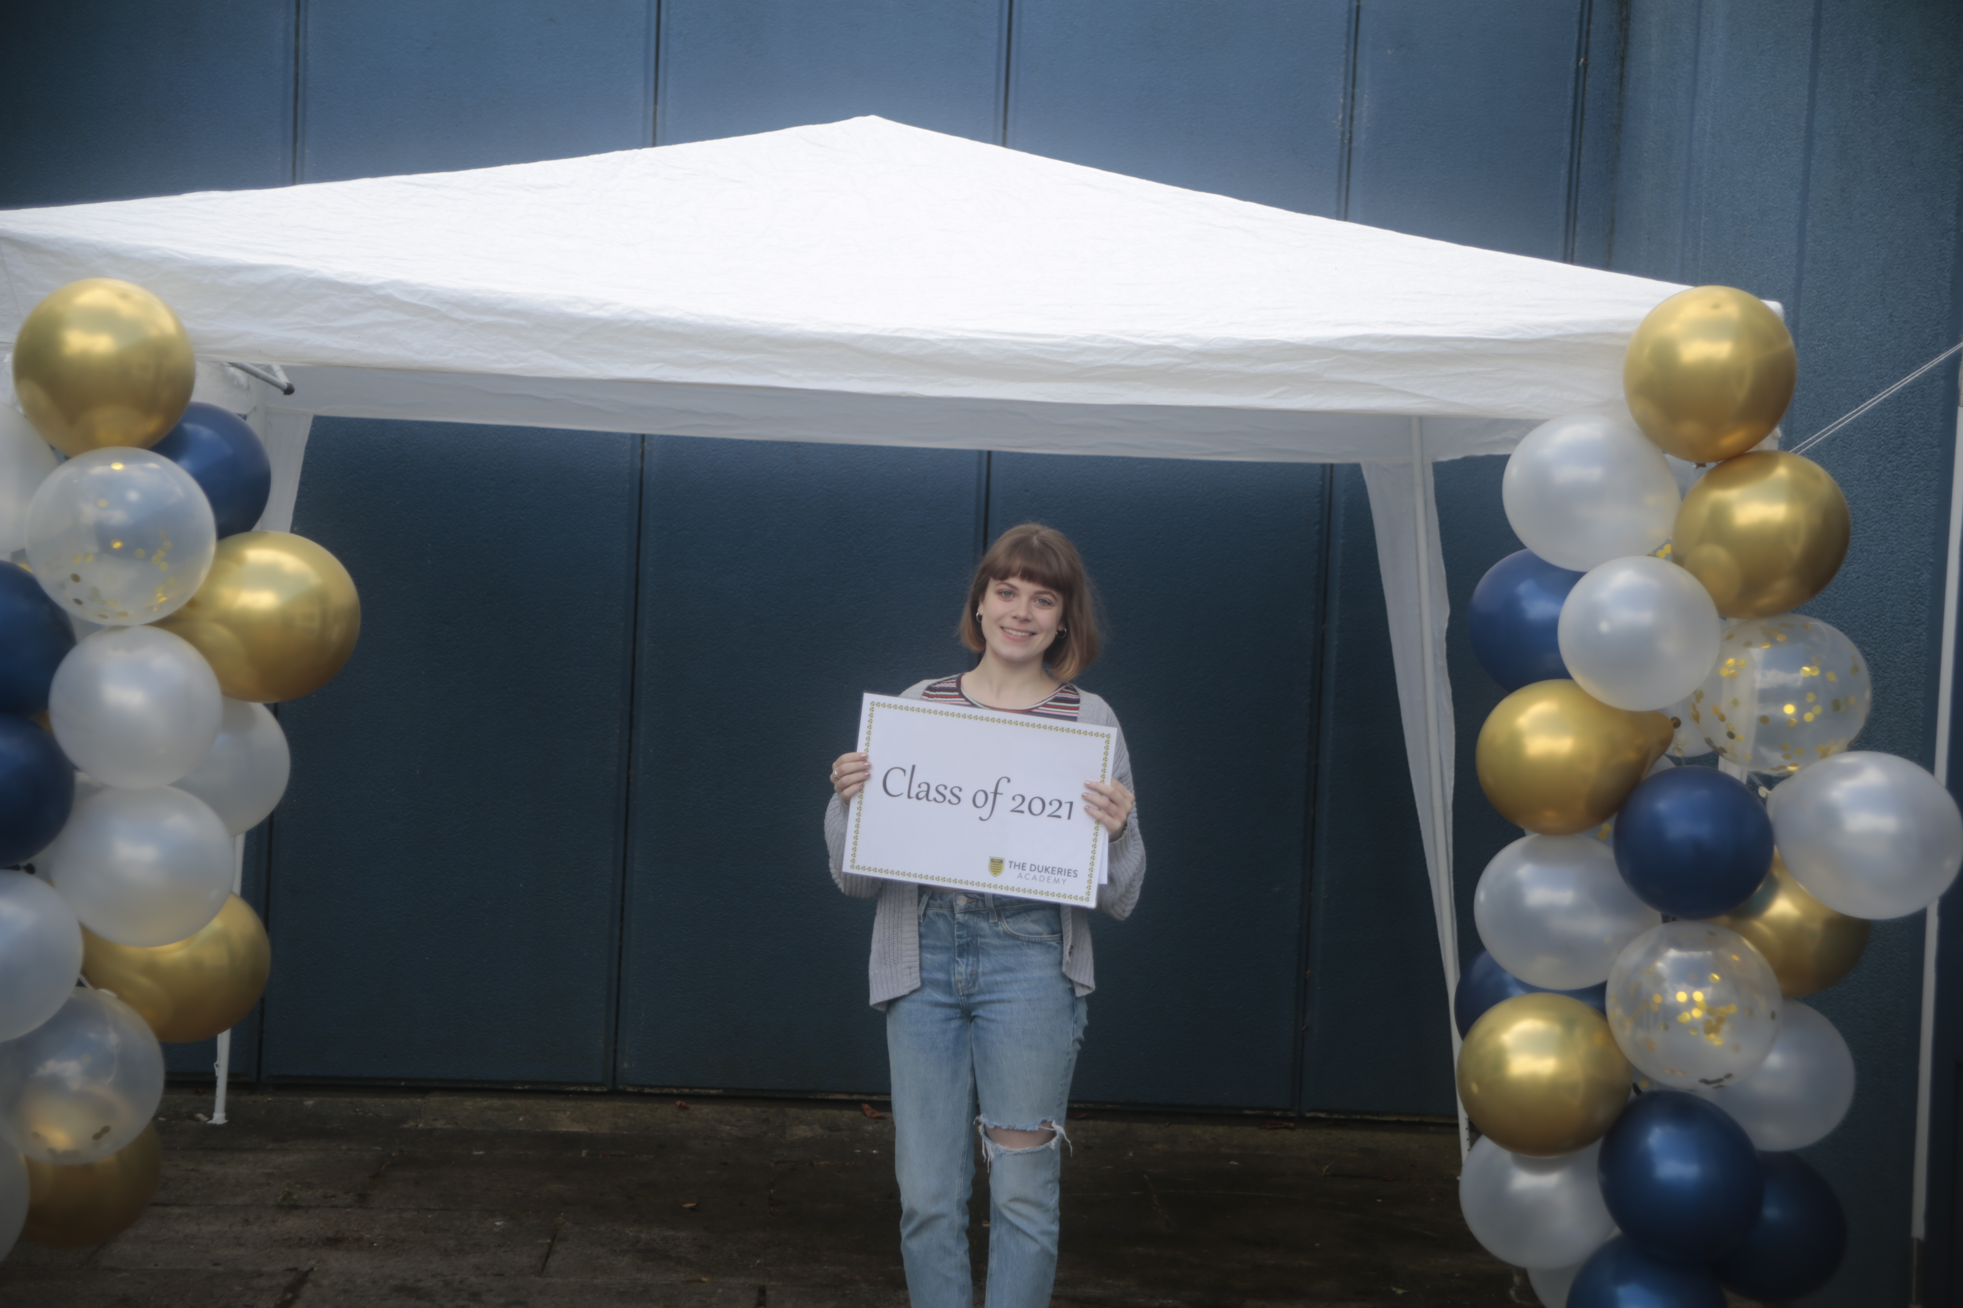
Alumni
Emily – finished her 1st year at Oxford
Emily – finished her 1st year at Cambridge
Jacob has graduated from Oxford and is completing his masters at St Andrews.
Graduated from Durham – working as an A level tutor for maths and physics here.

Slide 17
Questions
#GoodtoGreat

